Slide 1
Beyond gender binaries
Part III: Intersectionality and Structures of Power
Chapter 10: Hegemony and Structures of Power
Chapter 11: Discourses of Colonialism and Colonization
Chapter 12: Communicating Through Feminist and Intersectional Lenses
CINDY L. GRIFFIN

Slide 2
Chapter Ten: Hegemony and Structures of Power
Chapter Outline
In this chapter, you will find . . .
Hegemony and the Manufacturing of Consent
Defining Hegemony
How Ideas Become Hegemonic
Hegemony and Institutional Privilege and Bias
Understanding Institutional Privilege and Bias
Examples of Institutional Privilege and Bias
Hegemony and Systems of Privilege and Bias
Understanding Systems of Privilege and Bias
Systems Are Not Neutral
Hegemony and Structural Inequality
Intersectionality and Structures of Power

Slide 3
Chapter Ten: Hegemony and Structures of Power
Learning Objectives
After reading this chapter, you should be able to . . .
Define hegemony and explain the ways hegemonic discourses normalize certain ways of thinking and being in a society.
Explain institutional privilege and bias and give examples of that privilege and/or bias.
Describe systems that afford privilege and benefit to some, while denying it to others.
Critique the hegemonic discourses, institutional biases, and systems of privilege that perpetuate inequalities and name the ideologies that promote these structural inequities.

Slide 4
Chapter Ten: Hegemony and Structures of Power
Communication Checklist for Acknowledging Privilege
Acknowledge the harmful and oppressive legacies of our past.
Acknowledge how these legacies persist in our “national policies, institutional practices and cultural representations.”
Acknowledge how these legacies of oppression are transmitted, amplified, or mitigated through our private, public, and community institutions.
Acknowledge the ways individuals internalize and respond to these oppressive structures.
SOURCE: Keith Lawrence, Stacey Sutton, Anne Kubish, Gretchen Susi, and Karen Fulbright-Anderson, “Structural Racism and Community Building,” Aspen Institute Roundtable on Community Change, 2004,” Washington, D.C.: The Aspen Institute, 2004, 3, https://assets.aspeninstitute.org/content/uploads/files/content/docs/rcc/aspen_structural_racism2.pdf

Slide 5
Chapter Ten: Hegemony and Structures of Power
10.1 Guide to Communication: The Language of Hegemony (Part 1)
To help you explore the complex, but very real institutions, systems, and structures hegemonic discourses put into motion, and increase your ability to communicate effectively when faced with hegemonic notions of “right” and “wrong,” consider the following questions:
What is being presented as “normal” or “common sense”?
Who is telling me that this is “normal”—what are their identities and how full is their invisible knapsack?

Slide 6
Chapter Ten: Hegemony and Structures of Power
10.1 Guide to Communication: The Language of Hegemony (Part 2)
Can I begin to identify the institutional, systemic, and structural privileges that are operating in this situation?
What type of consent is being manufactured—what am I being encouraged to or discouraged from thinking or believing?
Using the ideas presented by the Aspen Institute, create a “Deep Fog” of privilege checklist that can help you become more aware of structural inequities. Your checklist should name the ways people can get themselves out of this “deep fog.” Now apply this checklist to one of the following structures of power covered in this book: racism, classism, ableism, sexism, homophobia, trans phobia, Islamophobia, xenophobia, or the like. What steps would you need to take to get out of these “deep fogs” of unawareness?

Slide 7
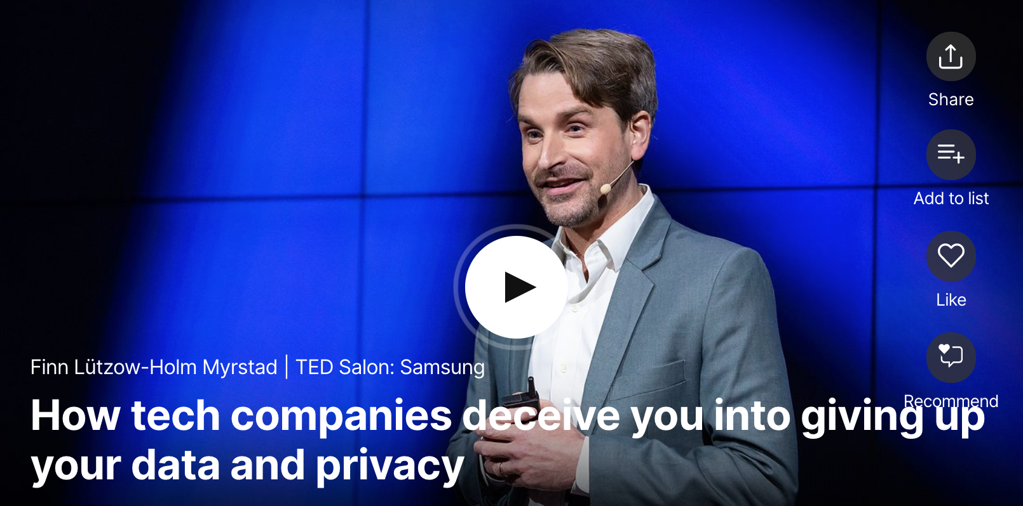
Chapter Ten:
The Language of Hegemony
Finn Lutzow-Holm Myrstad, “How Tech Companies Deceive you into Giving Data and Privacy,” filmed September 2018 in New York, New York, TEDsalon video

Slide 8
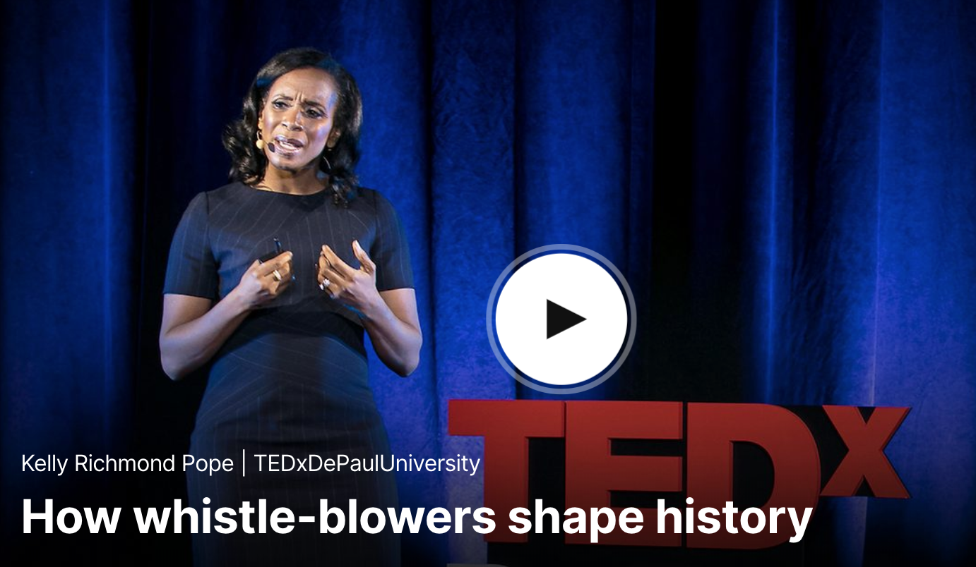
Chapter Ten:
The Language of Hegemony
Kelly Richmand-Pope, “How Whistle-Blowers Shape History,” filmed April 2017 in Chicago, Illinois, TEDXDePaulUniversity video

Slide 9
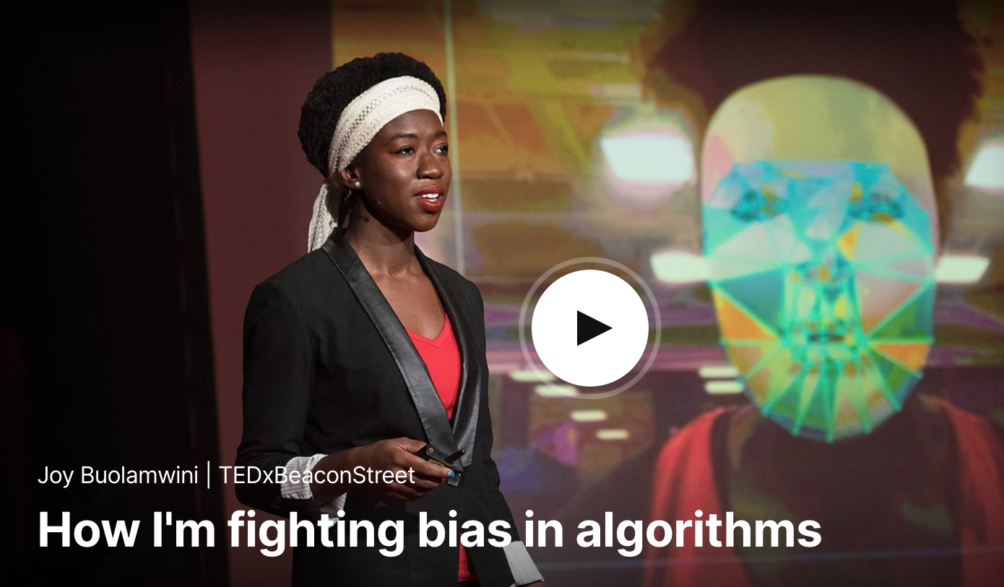
Chapter Ten:
The Language of Hegemony
Joy Buolamwini, “How I’m Fighting Bias in Algorithms,” filmed November 2016 in Brookline, Massachusetts, TEDxBeaconStreet video

Slide 10
Chapter Eleven: Discourses of Colonialism and Colonization
Chapter Outline
In this chapter, you will find . . .
No One Is Purely One Thing
Defining Colonialism and Colonization
Examples of Discourses of Colonialism and Colonization
Colonial Masculinity
Colonizing Indigenous Gender Systems
Colonizing the Burqa
Colonizing Our Gaze
Internalized Colonization
Beyond Colonizing Discourses

Slide 11
Chapter Eleven: Discourses of Colonialism and Colonization
Learning Objectives
After reading this chapter, you should be able to . . .
Define colonialism and colonization and explain how colonialism and colonization place cultures and countries in hierarchical rankings.
Explain the ideas behind colonial masculinity and the ways those ideas were challenged by indigenous ideas of masculinity.
Articulate the ways the burqa became an item for colonization during the War on Terror.
Define “the gaze” and identify the ways this gaze is present in much of our media and popular culture today.
Explain white fragility and identity fragility and describe the ways people can move beyond these feelings of fragility.

Slide 12
Chapter Eleven: Discourses of Colonialism and Colonization
11.1 Guide to Communication: Unpacking the Language of Colonization
To help you explore the complex concept of colonization and the ways it might be influencing your communication and your assumptions about individuals you see as different from you, consider the following questions:
What universal or homogenous identity is being advanced or accepted as right and normal in this description or exchange?
Whose identities are being erased or destroyed in this decision or approach to a problem or idea?
What do I really know about this culture, group of people, or individual?
What am I being encouraged to ignore or mis-understand of the history of this individual, culture, or group of people?

Slide 13
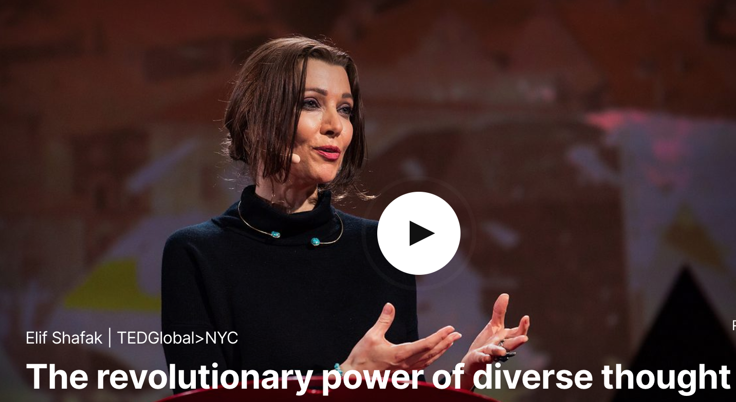
Chapter Eleven:
Discourses of Colonialism and Colonization
Elif Shafak, “The Revolutionary Power of Diverse Thought,” filmed September 2017 in New York, New York, TEDGlobal>NYC video

Slide 14
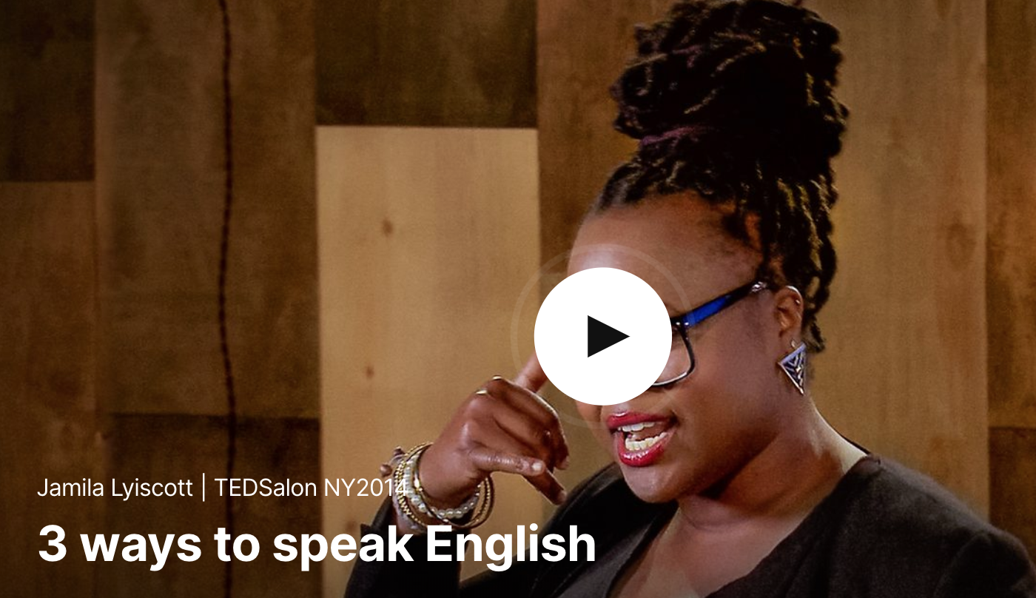
Chapter Eleven:
Discourses of Colonialism and Colonization
Jamila Lyiscott, “3Ways to Speak English,” filmed February 2014 in New York, New York, TEDSalon NY2014 video

Slide 15
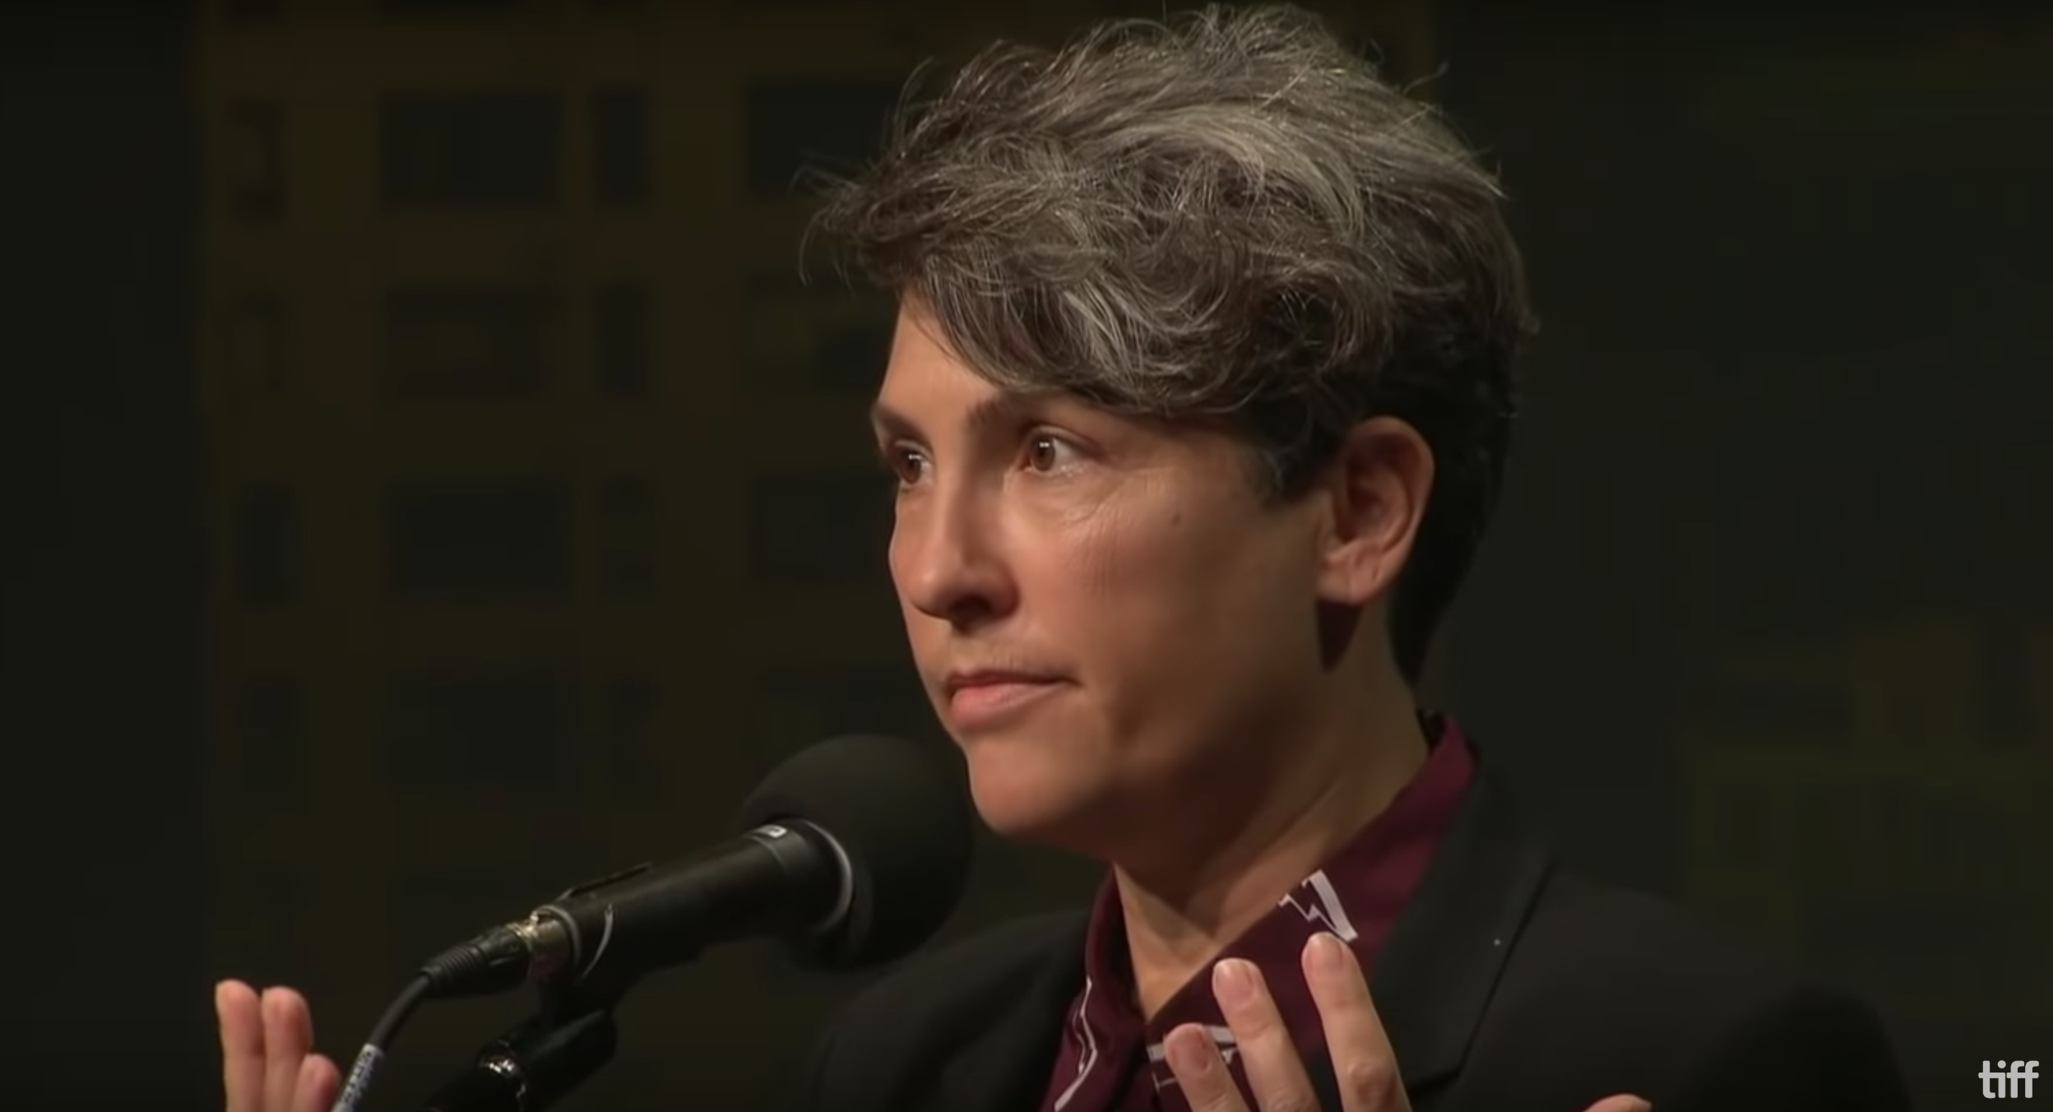
Chapter Eleven:
Discourses of Colonialism and Colonization
“Jill Soloway on the Female Gaze—Master Class—TIFF 2016,” YouTube video, 57:48, “TIFF Talks,” September 11, 2016

Slide 16
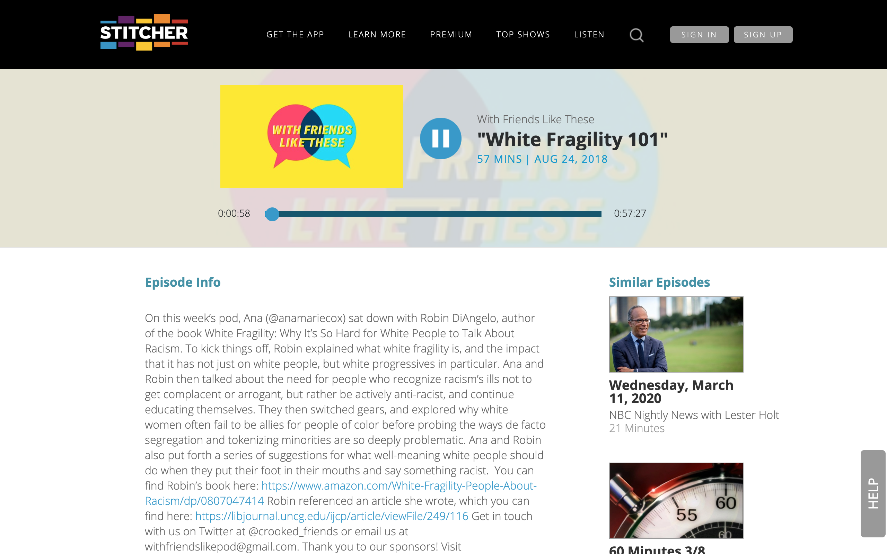
Chapter Eleven:
Discourses of Colonialism and Colonization
Ana Marie Cox, “With Friends Like These: ‘White Fragility 101,’” August 24, 2018, Stitcher video

Slide 17
Chapter Twelve: Communicating Through Feminist and Intersectional Lenses
Chapter Outline
In this chapter, you will find . . .
The Revolutionary Power of Diverse Thought
Invitational Strategies for Intersectional Communication
Listen to Difference
Reject Hierarchies of Humanness
Engage Discomfort
Correct Ourselves
Beyond Gender Binaries: Decolonizing our Bodies and Our Discourse
Decolonizing Our Bodies
Decolonizing Our Discourse
Power and Privilege as Constant Traveling Companions

Slide 18
Chapter Twelve: Communicating Through Feminist and Intersectional Lenses
Learning Objectives
After reading this chapter, you should be able to . . .
Explain the four things communicators can do in order to communicate from an intersectional orientation.
Define decolonization and explain how it disrupts binary thinking.
Describe the political/relational model of the body and disability and explain how it promotes the principle of universal moral respect.
Discuss branding and its relationship to the idea of rebellious bodies and identify examples of branding and rebellious bodies in our media.

Slide 19
Chapter Twelve: Communicating Through Feminist and Intersectional Lenses
Invitational Strategies for Intersectional Communication
Listen to Difference
Engage Discomfort
Reject Hierarchies of Humanness
Correct Ourselves

Slide 20
Chapter Twelve: Communicating Through Feminist and Intersectional Lenses
Decolonizing Our Bodies
medical/individual model
political/relational model
Which bodies are described as good/bad?
Which bodies are right/wrong, healthy/unhealthy, beautiful/ugly?
Which bodies are acceptable/unacceptable, dangerous/safe?
Which bodies are citizen/foreign?

Slide 21
Chapter Twelve: Communicating Through Feminist and Intersectional Lenses
Decolonizing Our Discourse
Branding Transgressive Bodies as
“sites of moral panic”
“social and economic burdens”
“a drain on the US welfare system”
inherently violent and dangerous
lazy and wanting handouts
alien and illegals
a danger to our children
modeling immoral behaviors
engaging in abnormal or oppressive religious practices and traditions
Branding Transgressive Bodies “creates an object upon which the American public can focus their emotions.” (Meuff)

Slide 22
Chapter Twelve: Communicating Through Feminist and Intersectional Lenses
12.1 Guide to Communication: Listening to Difference
To begin to work on the skills necessary to listen to difference, consider the reasons you offer to make your own case or advance your views.
Identify for yourself one or two topics or issues about which you feel passionate. Select one of those topics or issues for exploration.
Make a list of your own reasons for you views.
What values inform your position or view?
What underlying values might be at work in the views of those with whom you disagree?

Slide 23
Chapter Twelve: Communicating Through Feminist and Intersectional Lenses
12.2 Guide to Communication: Exploring Discursive Regimes
To help you begin to develop the skills you will need to reject hierarchies of humanness, consider what discourses of the past have been used to categorize individuals as “better” or “worse” humans. Explore whether and how such discursive regimes of “better” or “worse” are or are not possible today.
Make a list of the qualities you believe make someone human.
What discourses and reasons are you relying on to make your claims?
Now recount a narrative from history that tells us one person is more valuable than another (chapters 4-11 can help you identify these narratives).
What reasons, values and assumptions are being used to create this narrative?

Slide 24
Chapter Twelve: Communicating Through Feminist and Intersectional Lenses
12.3 Guide to Communication: Engaging Discomfort
To begin to work on the skills you will need to engage discomfort, take some time to examine your own hierarchies, phobias, and tendencies to disqualify other humans. This will give you insight into what you have learned to see as “normal” and why you feel uncomfortable in some communication exchanges.
Return to chapter 3 and reconsider the various ways you are not only privileged because of some of your identities, but also disadvantaged because of others.
Try to identify the ways that discussing your own kaleidoscope of privilege (both the advantages and the disadvantages) might cause you to feel uneasy.
Now dig deeper into this discomfort and try to identify the source of this unease: what hierarchies, phobias, and disqualifying myths are being exposed and challenged?
Even as you are uncomfortable with this new information, consider the new insights you gain about the complexity of our identities and the ways you might begin to communicate about that complexity with other people.

Slide 25
Chapter Twelve: Communicating Through Feminist and Intersectional Lenses
12.4 Guide to Communication: Welcoming Correction
Developing the skills we need to be open to correcting ourselves is not always easy. This is because discourses that support nonintersectional views are often invisible or difficult to spot. But welcoming correction is an important skill to develop because correction is part of growing in our intersectional understanding of ourselves and the world around us.
Take a moment and try to recall a time someone cared enough to point out a mistake you made during an exchange (as opposed to a hostile challenge to your views). They may have corrected a fact you presented, a line of reasoning you offered, an assumption you held as true and correct, or even the terms and phrases you used.
How did you receive this well-intentioned correction? Did you receive this correction with openness or did you bristle at the correction? Did you feel a bit embarrassed, or did you refuse to accept the correction at all?
Consider whether or not this mistake is one you would like to make again and why this is so?
What value system and approach to communication informs you answer to that final question?

Slide 26
Chapter Twelve: Communicating Through Feminist and Intersectional Lenses
12.5 Guide to Communication: Engaging Difference and Diversity Intersectionally
Consider the discursive regimes you take for granted and leave unexplored and unexamined. They might be related to religion, spirituality, food, exercise, education, medicine, clothing, entertainment, and more. What are the guiding principles for “normal” and “right” in these discursive regimes? What principles and practices might change if you decolonized those ideas of normal and right? How might your communication about these regimes change, as well?
If you are interested in exploring and getting to know ideas and people with whom you disagree, how might you begin to do so? Before you begin, consider how much discomfort you are willing to put yourself in. What information could this discomfort give you about who you are, your values, and the privileges you hold? How might you incorporate this information into your exposure to this difference? What would your goals be in engaging this difference?
Many of us want the world to be a “better place” and our communication often reflects this wish. One person’s “better” can be another person’s “worse,” however. In your conversations with other people, when your “better” encounters that other person’s “better,” and the two are at odds, what will you do? Consider the communication skills you have learned from this book and how you might use those skills to stand in the intersections with that person and explore colonization as well as decolonization.

Slide 27
Chapter Twelve:
Communicating Through Feminist and Intersectional Lenses
Elif Shafak, “The Revolutionary Power of Diverse Thought,” filmed September 2017 in New York, New York, TEDGlobal>NYC video

Slide 28
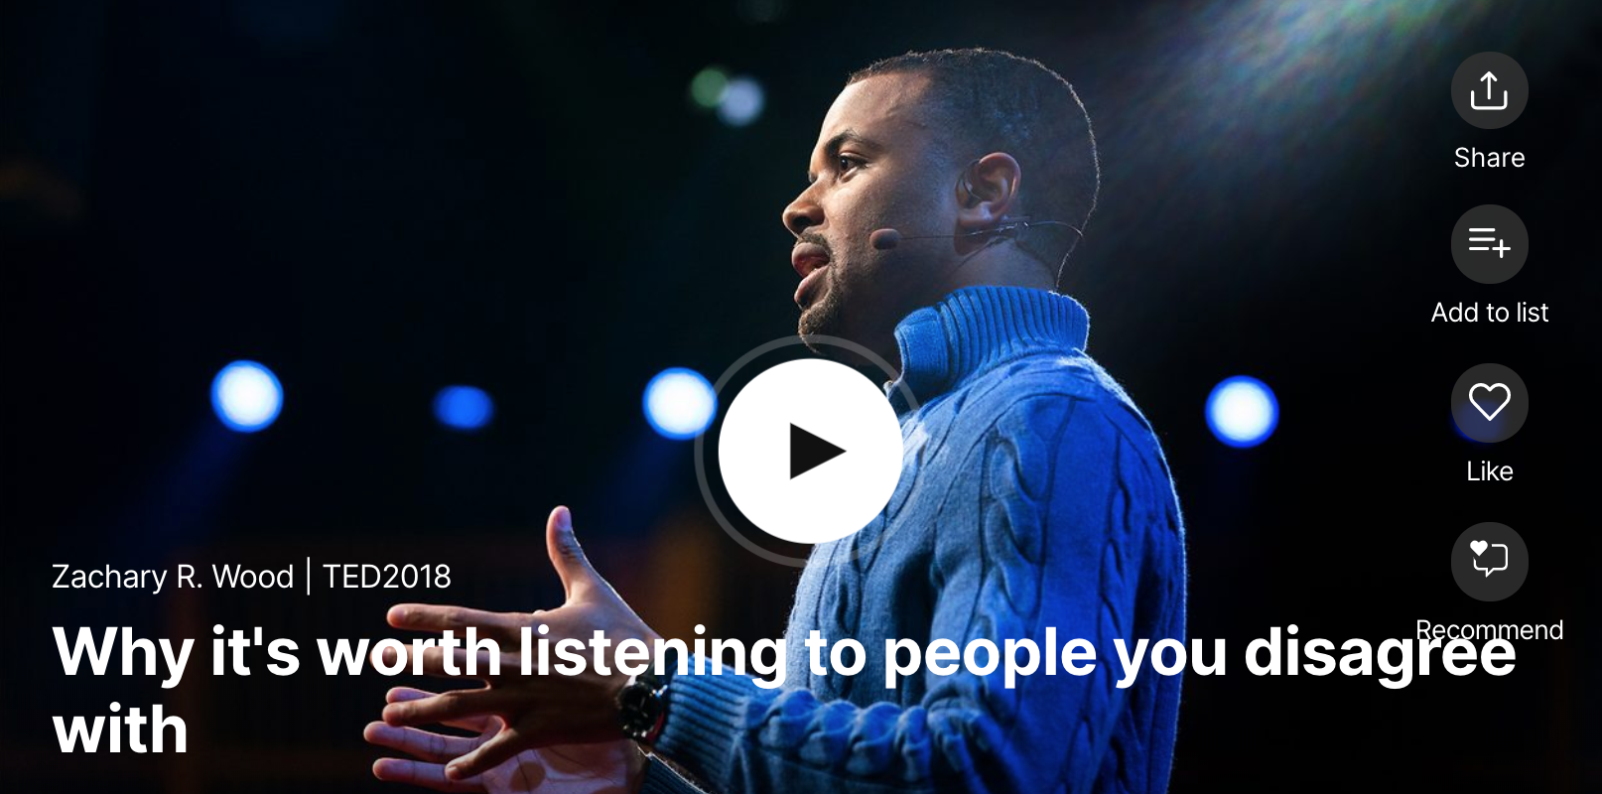
Chapter Twelve:
Communicating Through Feminist and Intersectional Lenses
Zachary R. Wood, “Why It’s Worth Listening to People You Disagree With,” filmed April 2018 in Vancouver, British Columbia, Canada, TED2018 video

Slide 29
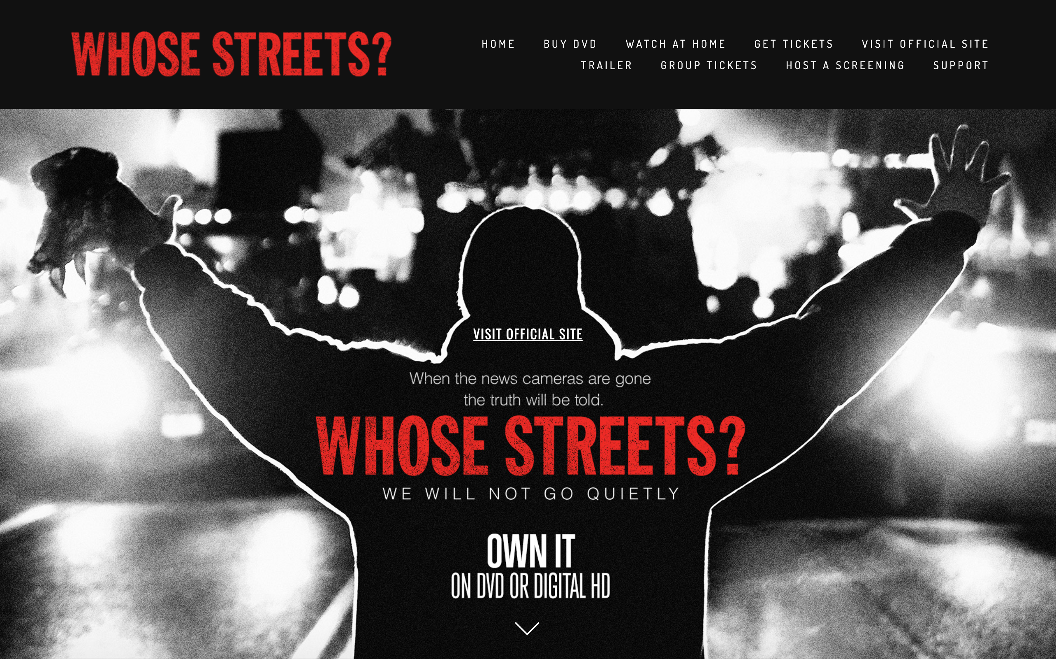
Chapter Twelve:
Communicating Through Feminist and Intersectional Lenses
Sabaah Folayan (Director, Producer), Whose Streets? Official Site, 2017

Slide 30
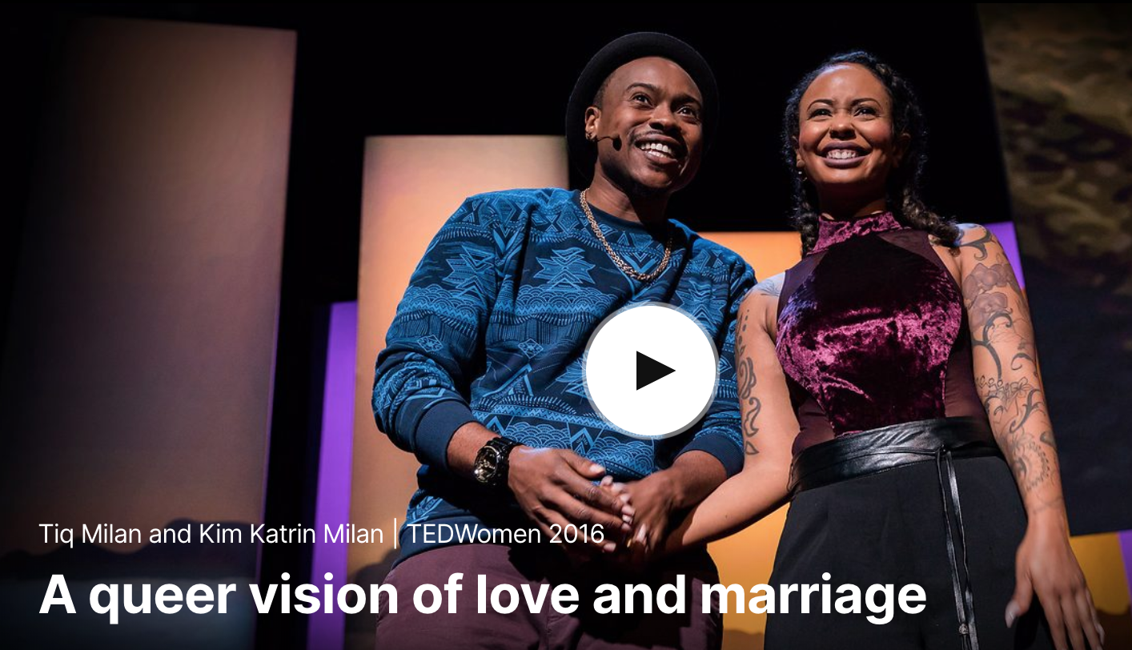
Chapter Twelve:
Communicating Through Feminist and Intersectional Lenses
Tiq Malin and Kim Katrin Malin, “A Queer Vision of Love and Marriage,” filmed October 2016 in San Francisco, California, TEDWomen 2016 video

