Slide 1
Beyond gender binaries
Part II (a): Feminist Intersectional Orientations to Rights
Chapter 4: Intersectional Approaches to Personhood and Citizenship
Chapter 5: Intersectional Approaches to Safety in Public Spaces
Chapter 6: Intersectional Approaches to Safety in Private Spaces
CINDY L. GRIFFIN

Slide 2
Chapter Four: Intersectional Approaches to Personhood and Citizenship
Chapter Outline
In this chapter, you will find . . .
The Right to Be Considered Fully Human
The Right to Personhood: Hierarchies of Humanness
Criteria for Personhood: The Discourse of Undesirable Traits
The Right to Citizenship: The Discourse of Belonging
Criteria for Incivility: Discourses of Social Polarization
Human Rights, Civility, and Universal Moral Respect

Slide 3
Chapter Four: Intersectional Approaches to Personhood and Citizenship
Learning Objectives
After reading this chapter, you should be able to . . .
Summarize the various laws that made it legal to own another human.
Describe the discourse of undesirable traits and the ways this discourse was used to deny individuals’ human rights.
Evaluate the discourses of social polarization and assess the ways they promote uncivil communication.
Explain the principle of universal moral respect and the ways it can inform communication.

Slide 4
Chapter Four: Intersectional Approaches to Personhood and Citizenship
Communication Checklist for Civility
When we engage one another with civility, we do not begin by defending our own position. As we struggle to engage with other people civilly, we take time to communicate with other people rather than argue with them. Our goal is not to prove we are correct and they are wrong—that can happen at another time, if necessary.
Explore the Claims. Take time to explore the claims, statistics, sources of information, biases, and omissions from both sides. What is being said? What support is offered? What is left out? How is each argument progressing logically and emotionally?
Consider the Source. We must also consider the identities, privileges, values, histories, needs, commonalities, and differences of those making the statements.

Slide 5
Chapter Four: Intersectional Approaches to Personhood and Citizenship
Communication Checklist for Civility (continued)
Who is asking for change? What kind of change is this person asking for? What are the experiences and background of this person—what identities do they bring to the conversation?
Share Perspectives. We share perspectives, information, and our identities in the spirit of exploring options and ideas.
Find Common Ground. We find some common ground and express care and concern for our fellow human beings—even as we disagree.
Unpack Differences Respectfully. Unpack and explore our differences as respectfully and honestly as is possible.
State Understanding as Goal. We accept that the goal of civil communicators is not to defend our position but rather to understand issues as fully as possible—as intersectionally as possible.

Slide 6
Chapter Four: Intersectional Approaches to Personhood and Citizenship
4.1 Guide to Communication: Civility and Universal Moral Respect
Before you enter conversations and discussions about personhood, citizenship, rights and respect, take time to consider the following questions:
What hierarchies of identity and humanness are present?
What undesirable traits are being said to exist?
Are laws or practices being advocated that frame or define identities, rights, belonging and even human nature in hierarchal ways?
In what ways could invitational rhetoric, civility, and intersectional orientations be added to this conversation productively?
Are there times when incivility, argument, and flat-out disagreement are warranted—when might they be?

Slide 7
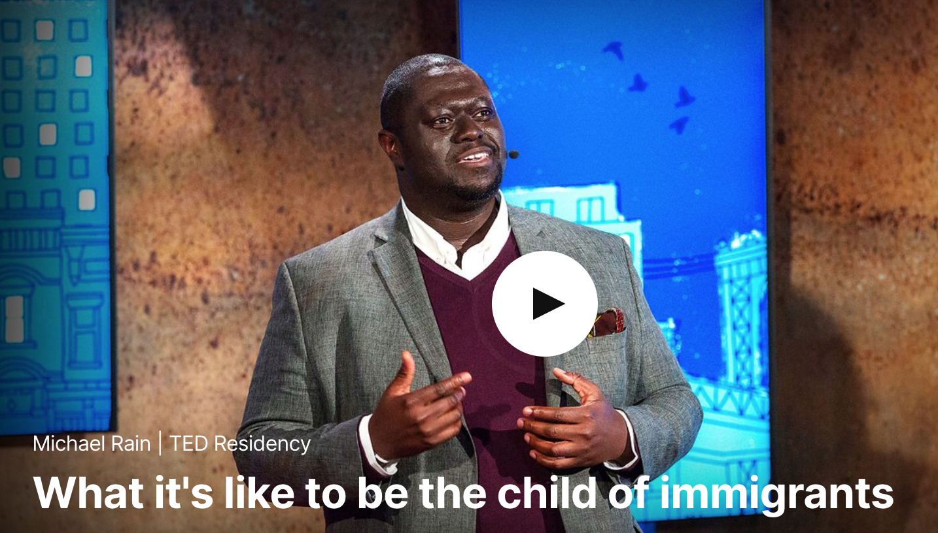
Chapter Four: Intersectional Approaches to Personhood and Citizenship
Michael Rain, “What’s It Like to be the Child of Immigrants,” filmed November 2017 in New York, New York, TED Residency video

Slide 8
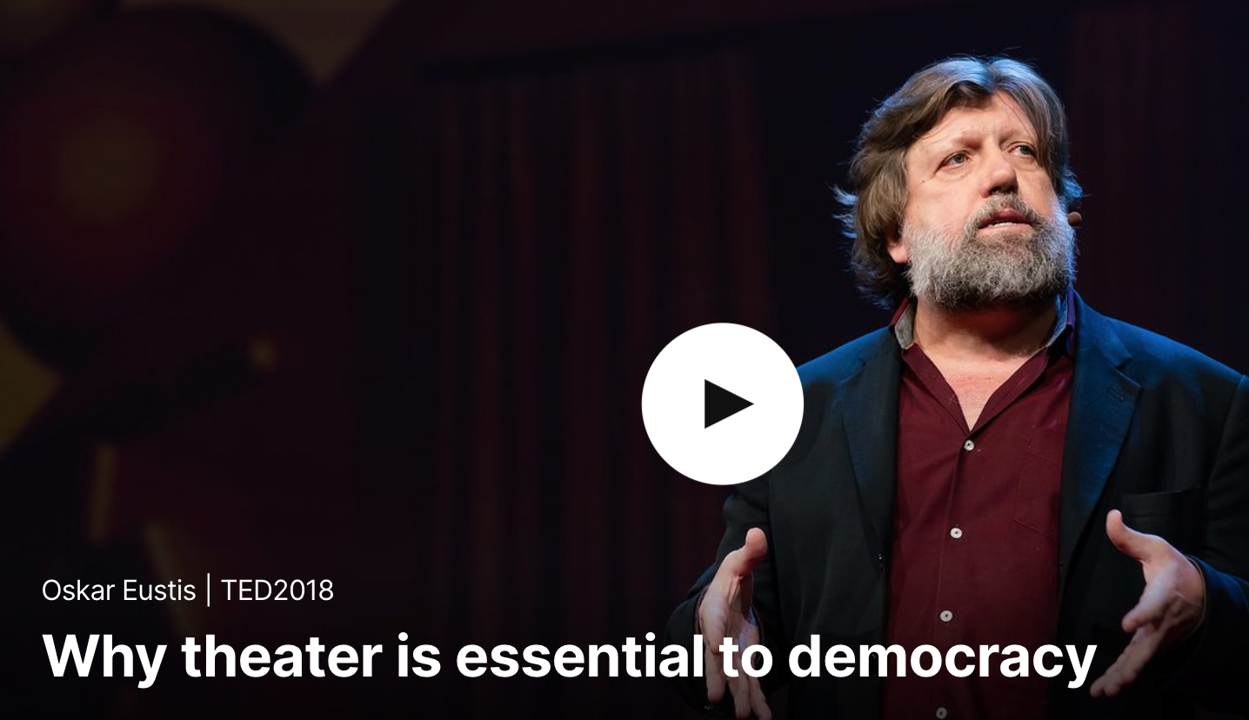
Chapter Four: Intersectional Approaches to Personhood and Citizenship
Oskar Eustis, “Why Theatre is Essential to Democracy,” filmed April 2018 in Vancouver, BC, Canada, TED2018 video

Slide 9
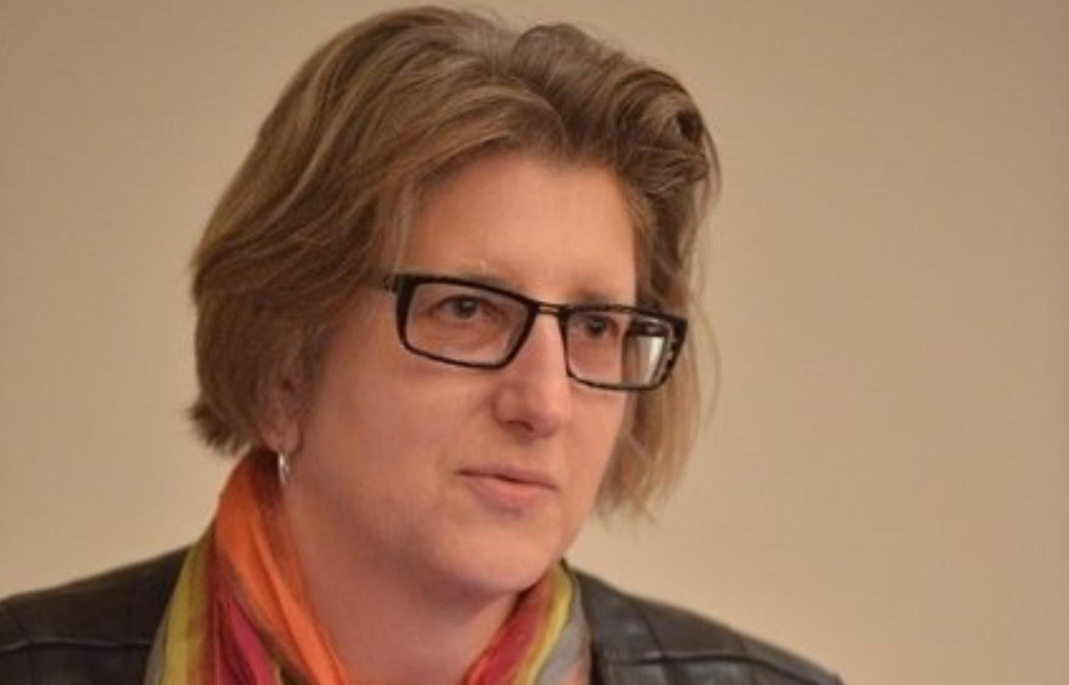
Chapter Four: Intersectional Approaches to Personhood and Citizenship
“On a ‘Eugenics Registry,’ A Record of California’s Thousands of Sterilizations,” National Public Radio Weekend Edition Sunday, December 18, 2016

Slide 10
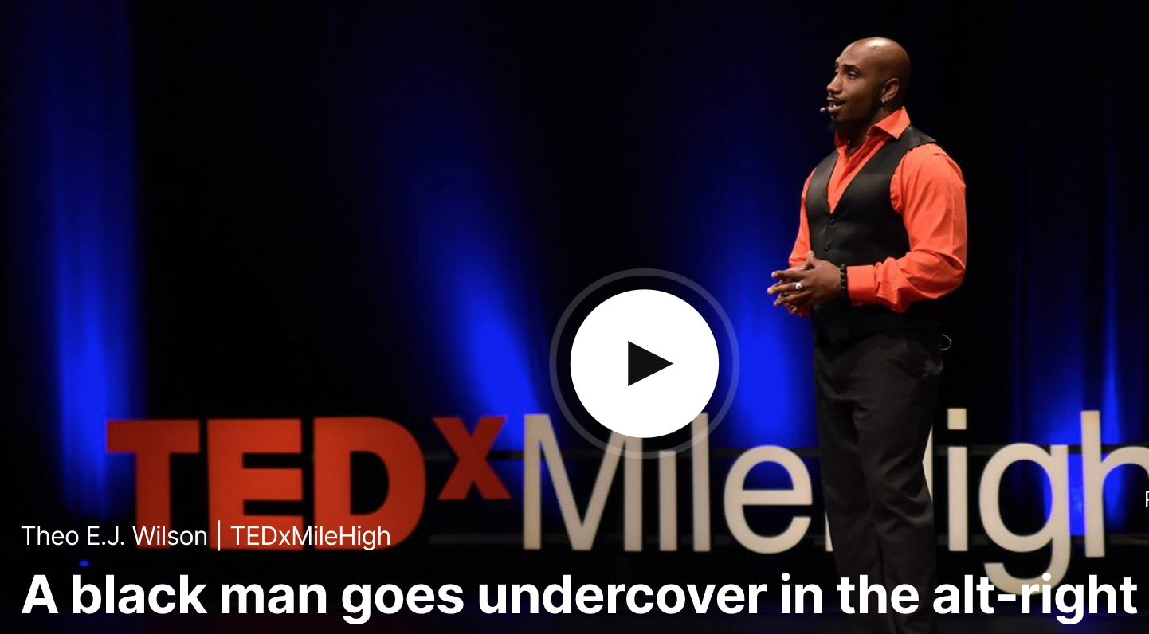
Chapter Four: Intersectional Approaches to Personhood and Citizenship
Theo E. J. Wilson, “A Black Man Goes Undercover in the Alt-Right,” filmed December 2017 in Denver, Colorado, TEDxMileHigh video

Slide 11
Chapter Five: Intersectional Approaches to Safety in Public Spaces
Chapter Outline
In this chapter, you will find . . .
The Right to Safety
Discourses of Harassment
The Many Faces of Street Harassment
The Many Faces of Cyber Harassment
Hate Speech
Policing Masculinity: Violence Against Black and Latino Boys and Men
Criminalizing Normal Behaviors
Crime Myths and Scapegoating
Gentrification and Gang Injunctions
A Discursive Regime of Danger
The Absence of Democracy
The Work Our Words Do

Slide 12
Chapter Five: Intersectional Approaches to Safety in Public Spaces
Learning Objectives
After reading this chapter, you should be able to . . .
Describe the discourses of harassment and hate, including street harassment, cyber harassment, and hate speech.
Assess the criminalization of normal youth behaviors and the way it contributes to the policing of masculinity.
Explain the impacts of discourses that perpetuate crime myths, scapegoating, gentrification and gang injunctions on young men of color.
Analyze the ways in which the discursive regime of danger undermines basic democratic values.
Explain the phrase, “are we using language, or is language using us?”

Slide 13
Chapter Five: Intersectional Approaches to Safety in Public Spaces
Type of Street Harassment | Percentage of Women Experiencing It
Leering | 95%
Honking and Whistling | 94%
Sexist Comments | 87%
Vulgar Gestures | 82%
Sexually Explicit Comments | 81%
Kissing Noises | 77%
Following | 75%
Blocking Paths | 62%
Sexual Touching or Grabbing | 57%
Masturbating | 37%
Assaulting | 27%
Street Harassment Statistics
SOURCE: Holly Kearl, Stop Street Harassment: Making Public Places Safe for Women (Santa Barbara: Praeger, 2010) 11-15; “Street Harassment Statistics,” 2015, https://www.ilr.cornell.edu/news/street-harassment-statistics and “Statistics--Street Harassment Studies,” 2018, http://www.stopstreetharassment.org/resources/statistics/sshstudies/

Slide 14
Chapter Five: Intersectional Approaches to Safety in Public Spaces
5.1 Guide to Communication: Communicating Safety Intersectionally
As you explore intersectional communication as it relates to safety in public spaces and places, consider the following questions:
Discuss free speech in the context of street and cyber harassment. Are these forms of communication protected under the First Amendment to our Constitution?
Make a list of the words you use to describe groups of people who avow to identities different from your own. Write them down so that you can spend time unpacking their meanings and considering their impact if you use them in your everyday communication.
As a class, discuss the phrases “it’s just a joke” and “it’s no big deal.” Consider when those phrases diminish and trivialize the harms being done to someone and the differences between saying those phrases to someone else and having them said to you.
Reflect on Anthony Cortese’s statement that hate speech is seldom an invitation to politely chat. Are there ways of communicating our dislike of someone that are invitations to conversation? What can feminism and intersectionality add to conversations about our dislike of other people?

Slide 15
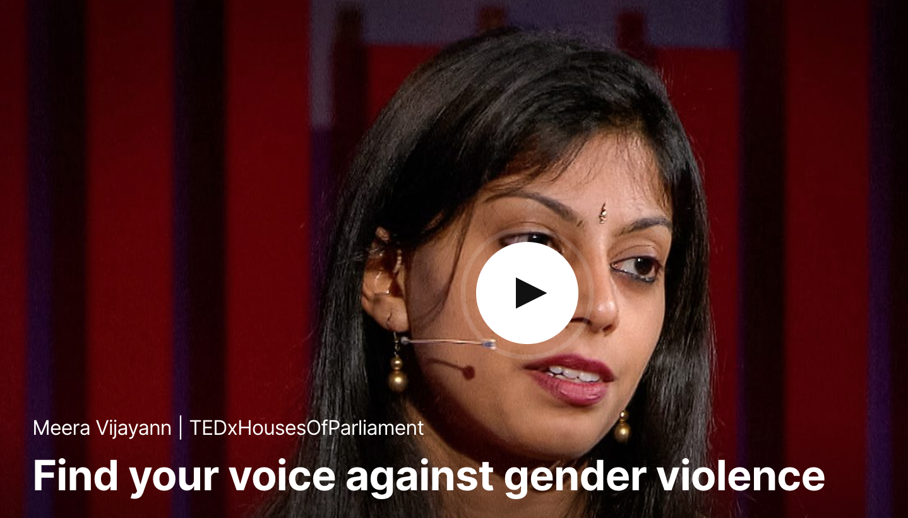
Chapter Five: Intersectional Approaches to Safety in Public Spaces
5.1 Guide to Communication: Communicating Safety Intersectionally
Consider Meera Vijaynn’s call for women to speak out against gender violence in her TED talk “Find Your Voice Against Gender Violence,” TEDxHousesOfParliament, 2014. What might be the implications of responding to her call for you, your friends and family, and society at large?

Slide 16
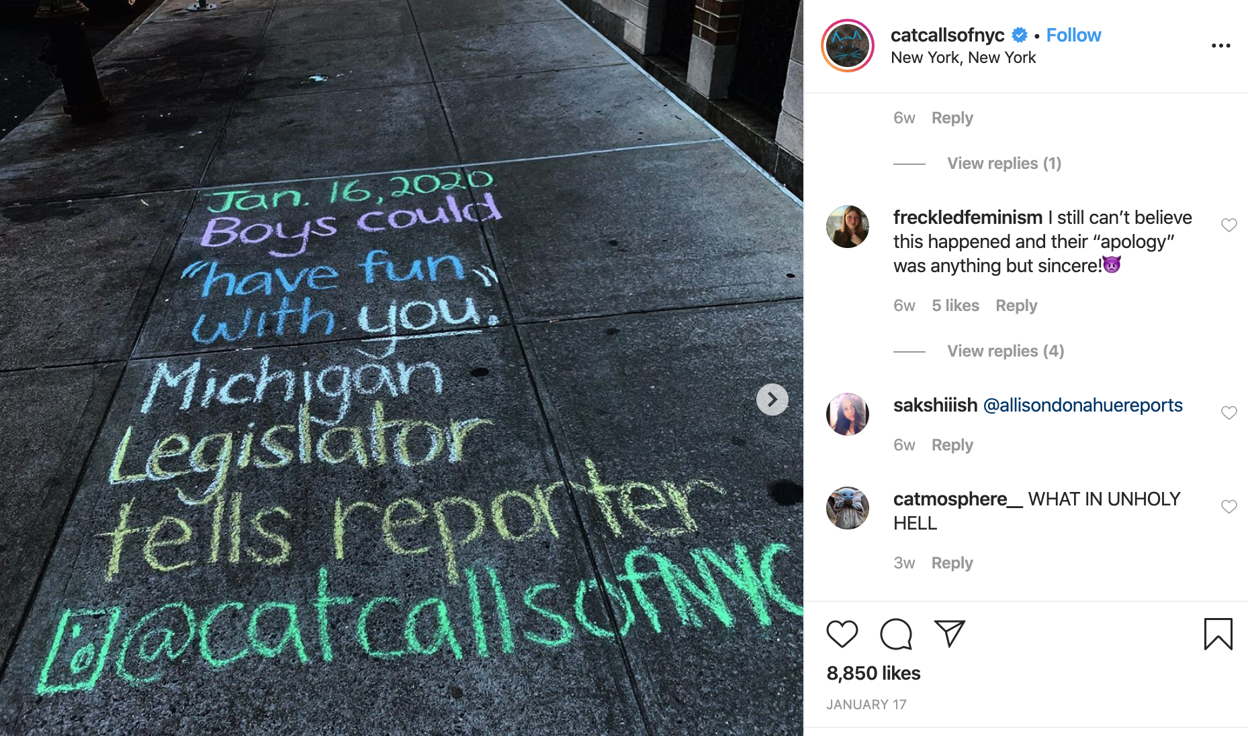
Chapter Five: Intersectional Approaches to Safety in Public Spaces
Sophie Sandberg founded Catcalls of NYC when she was a freshman at New York University. Growing up in New York, Sandberg shares that catcalls, a daily occurrence in her and her friends’ lives, always made them very uncomfortable, confused, and feel powerless. On her popular Instagram account, @CatcallsofNYC

Slide 17
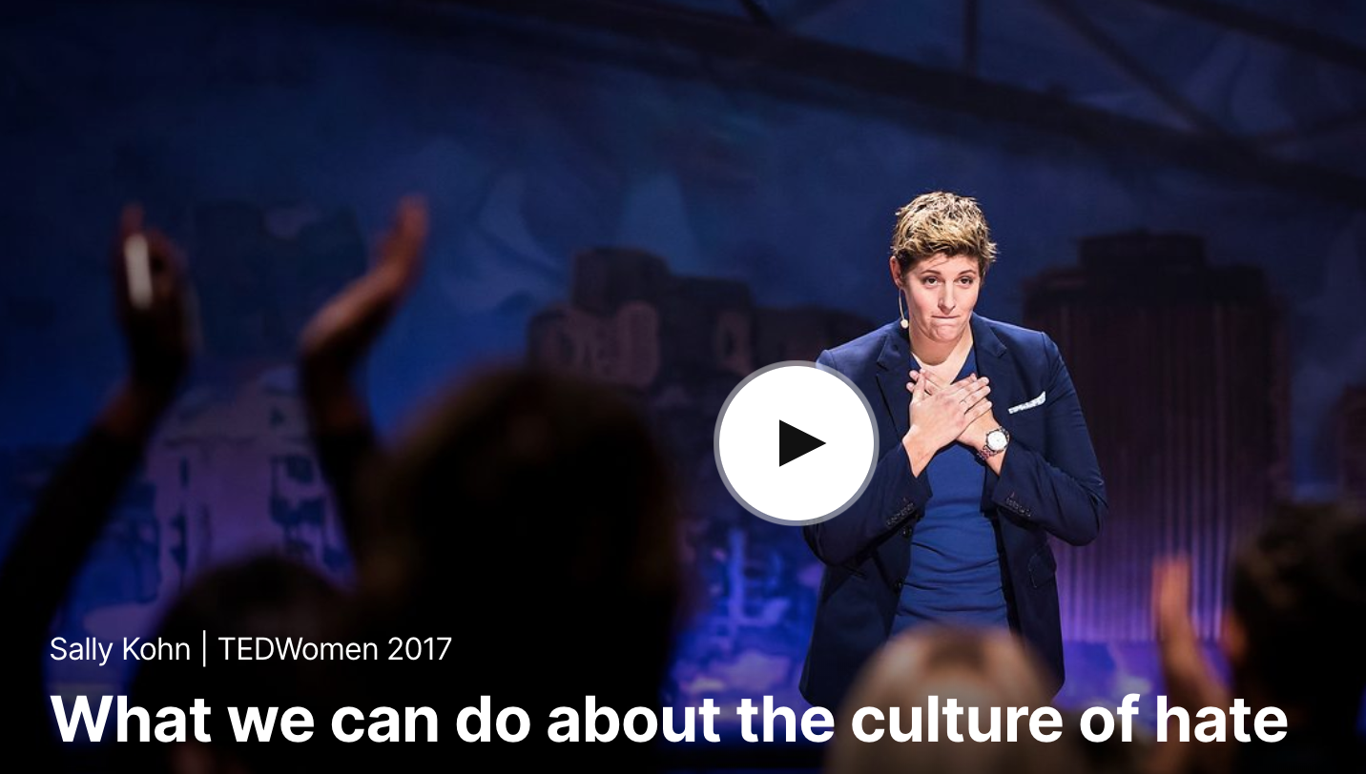
Chapter Five: Intersectional Approaches to Safety in Public Spaces
Sally Kohn, “What Can We do About the Culture of Hate,” filmed November 2017 in New Orleans, Louisiana, TEDWomen 2017 video

Slide 18
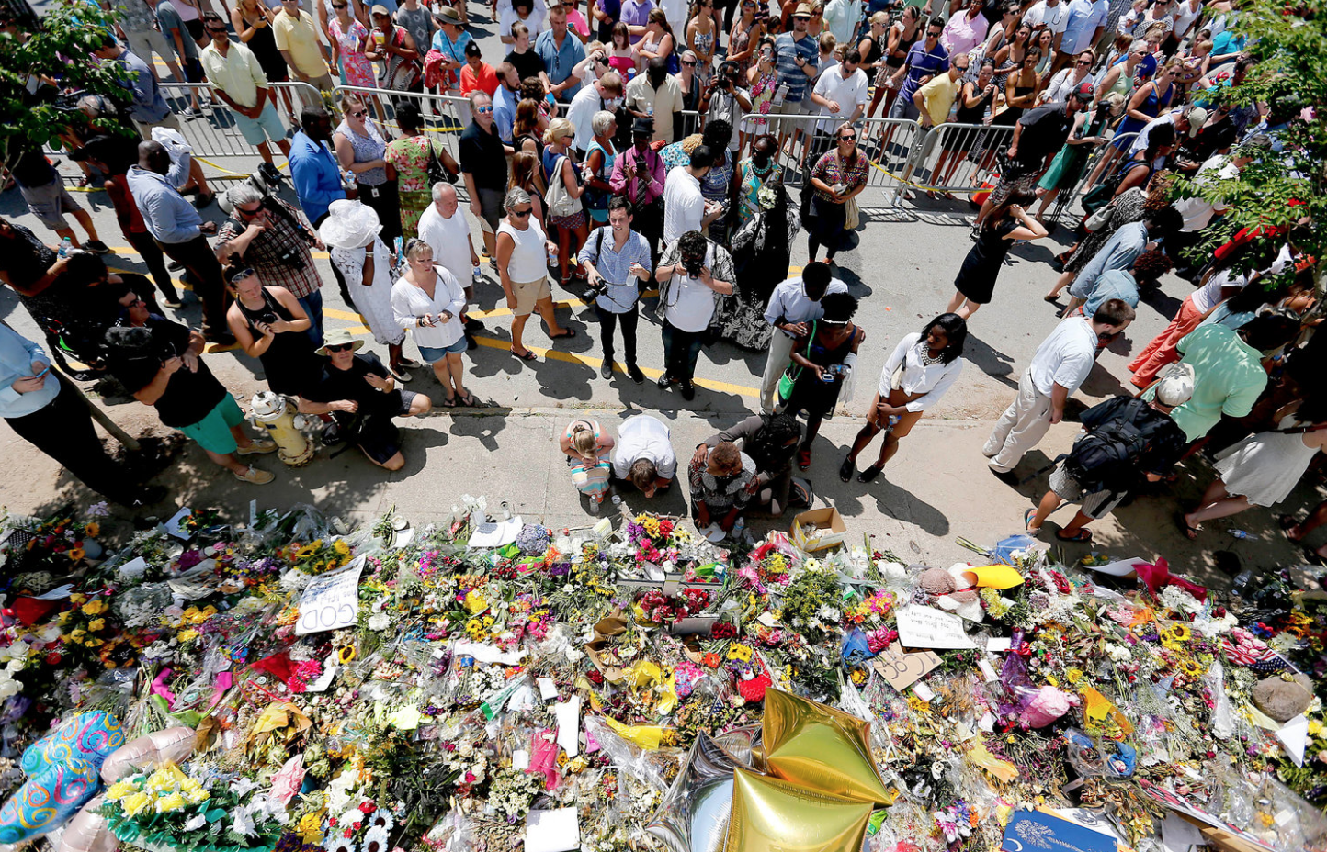
Chapter Five: Intersectional Approaches to Safety in Public Spaces
Camila Domonoske, “Hate Crimes Rose in 20115, With Religious Bias a Growing Motivation, FBI Data Shows,” National Public Radio, November 14, 2016

Slide 19
Chapter Six: Intersectional Approaches to Safety in Private Spaces
Chapter Outline
In this chapter, you will find . . .
In Praise of Insubordination
The Right to Safety in Private Spaces
Defining Interpersonal Violence
Defining Sexual Violence
Targets and Perpetrators of Interpersonal and Sexual Violence
Intersecting Systems of Power and Oppression
Rape Myths and Rape Scripts
The Unrapeable Myth
Societal and Historical Traumas
Cultural and Social Norms
The Lie of Entitlement
Rewriting the Scripts

Slide 20
Chapter Six: Intersectional Approaches to Safety in Private Spaces
Learning Objectives
After reading this chapter, you should be able to . . .
Explain different forms of interpersonal violence.
Identify false beliefs related to sexual violence.
Describe what constitutes rape culture.
Evaluate the danger of hypermasculine ideologies.
Assess factors leading to underreporting of sexual violence.
Construct an intersectional framework for rewriting cultural scripts about sex and entitlement in relation to interpersonal violence.

Slide 21
Chapter Six: Intersectional Approaches to Safety in Private Spaces
Rape Myths: True or False? (Part 1)
Women routinely lie about rape.
Only “certain kinds” of women are raped.
Although most women wouldn’t admit it, they generally find being physically forced into sex a real “turn-on.”
If a woman doesn’t fight back, you can’t really say that it was rape.
Men from nice middle-class homes almost never rape.
Women who wear low cut tops or sexy clothing are just asking for trouble.

Slide 22
Chapter Six: Intersectional Approaches to Safety in Private Spaces
Rape Myths: True or False? (Part 2)
If a woman has no bruises, scratches or marks, rape probably really didn’t happen.
Women tend to exaggerate how much rape affects them.
Boyfriends almost never rape their girlfriends.
Stranger rape is the most common kind of rape.
Women who claim they were raped just have emotional problems or want to get back at men.
Rape is rare in middle and high schools.
Rape happens when a man’s sex drive gets out of control.

Slide 23
Chapter Six: Intersectional Approaches to Safety in Private Spaces
Rape Myths: FALSE
Although many people respond to each statement with true,
the accurate response to each statement is false.

Slide 24
Chapter Six: Intersectional Approaches to Safety in Private Spaces
Violence Against Women (Part 1)
Using a binary framework for reporting their data, the World Health Organization explains that violence “against women—particularly intimate partner violence and sexual violence—is a major public health problem and a violation of women’s human rights.” Decades of research indicate that interpersonal violence can take many forms.
Physical | Use of force causing injury, including hair pulling, punching, kicking, slapping, stabbing, choking, forcing drugs or alcohol; making someone hurt physically; causing injury or even death.
Sexual | Sexual assault, molestation, rape, unwelcome touching; coercing someone into not using contraception; coercing someone into having sex with others.

Slide 25
Chapter Six: Intersectional Approaches to Safety in Private Spaces
Violence Against Women (Part 2)
Financial | Controlling the finances, preventing someone from going to school or taking a job.
Psychological | Undermining someone’s worth by insulting, humiliating, criticizing, and Destroying their self-esteem; threatening, intimidating, or fear-causing behaviors; controlling behaviors such as needing ‘permission’ to go out or talk to someone; monitoring cell phone or social media accounts; extreme jealousy and insecurity; isolating them from community, family and friends; blackmail.
Verbal | Screaming, shouting, swearing, name calling, insulting, often accompanied by emotional and psychological abuse. Posting insulting and humiliating information on social media accounts.

Slide 26
Chapter Six: Intersectional Approaches to Safety in Private Spaces
Violence Against Women (Part 3)
Stalking | Loitering, watching, following; persistent phone calls, texts, emails; unwanted love letters or gifts.
Spiritual | Mocking, ridiculing, putting down religious and spiritual beliefs and practices; not allowing someone to participate in spiritual or religious events, practices, and worship.
Legal | Refusing to sign, file or give access to papers that confer legal status; hiding mail or documents necessary to obtain legal status; threatening to deport; threatening to take away or harm children; violating restraining orders that protect the person and their children.

Slide 27
Chapter Six: Intersectional Approaches to Safety in Private Spaces
Categories of Sexual Violence
Forced penetration of a person, either attempted or completed.
Alcohol/drug facilitated penetration of a person, either attempted or completed.
Forced acts in which a person is made to penetrate another person, either attempted or completed.
Alcohol/drug facilitated acts in which a person is made to penetrate another person, either forced or completed.
Forced acts of penetration, either attempted or completed, because of a misuse and abuse of authority, or resulting from verbal pressure or intimidation by another person.
Unwanted sexual contact.
Unwanted sexual experiences that occur verbally (i.e. sexual harassment) or visually (i.e. exposure to pornography).
SOURCE: Centers for Disease Control and Prevention (CDC)

Slide 28
Chapter Six: Intersectional Approaches to Safety in Private Spaces
6.1 Guide to Communication: Exposing the Lie of Entitlement (Part 1)
This exploration of the right to be safe in private and social settings, that is, free from interpersonal and sexual violence, has exposed some painful truths: for some, power and control define their relationships, rape myths and scripts are prevalent, and they, in tandem with societal and historical traumas as well as social and cultural norms, fuel the underreporting of sexual assault. The lie of entitlement overwhelms us with devastating assumptions about what interpersonal violence and sexual assault really mean and do. As you consider your communication around the tragedy and trauma of interpersonal and sexual violence, ask yourself the following questions:
In what ways might my own communication, or the communication I hear and see around me, do any of the following: insult, humiliate, criticize, or destroy someone’s self-esteem; threaten, intimidate, or cause fear; control someone’s behaviors or give them permission to do something; display extreme jealousy and insecurity? What does this communicate about entitlement the lies it perpetuates?

Slide 29
Chapter Six: Intersectional Approaches to Safety in Private Spaces
6.1 Guide to Communication: Exposing the Lie of Entitlement (Part 2)
Where have I encountered narratives that subscribe to rape myths and scripts? Did I hear them from a person I was speaking with, or the media I watched, or someplace else? What can these myths and scripts tell me about our cultural understanding of sexual violence?
What might communication about sexual and interpersonal violence look like if it were more aware and respectful of societal and historical traumas?
Have I seen the male emotional funnel system or the lie of entitlement in media, conversations with friends and family, or other places? How might I talk with the people I know, however old or young, about the male emotional funnel system, the lie of entitlement, and the damage they do? What might those conversations look like, and with whom would I talk?

Slide 30
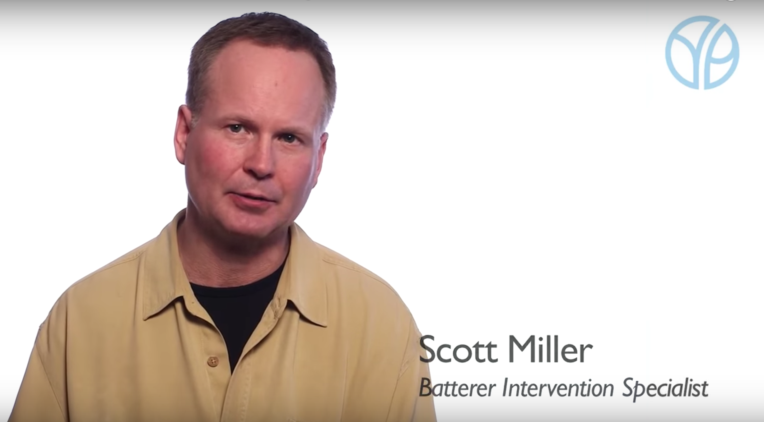
Chapter Six: Intersectional Approaches to Safety in Private Spaces
“Power and Control Wheel,” Domestic Abuse Intervention Programs, Duluth, MN, and “Understanding the Power and Control Wheel,” posted May 2, 2016, YouTube video

Slide 31
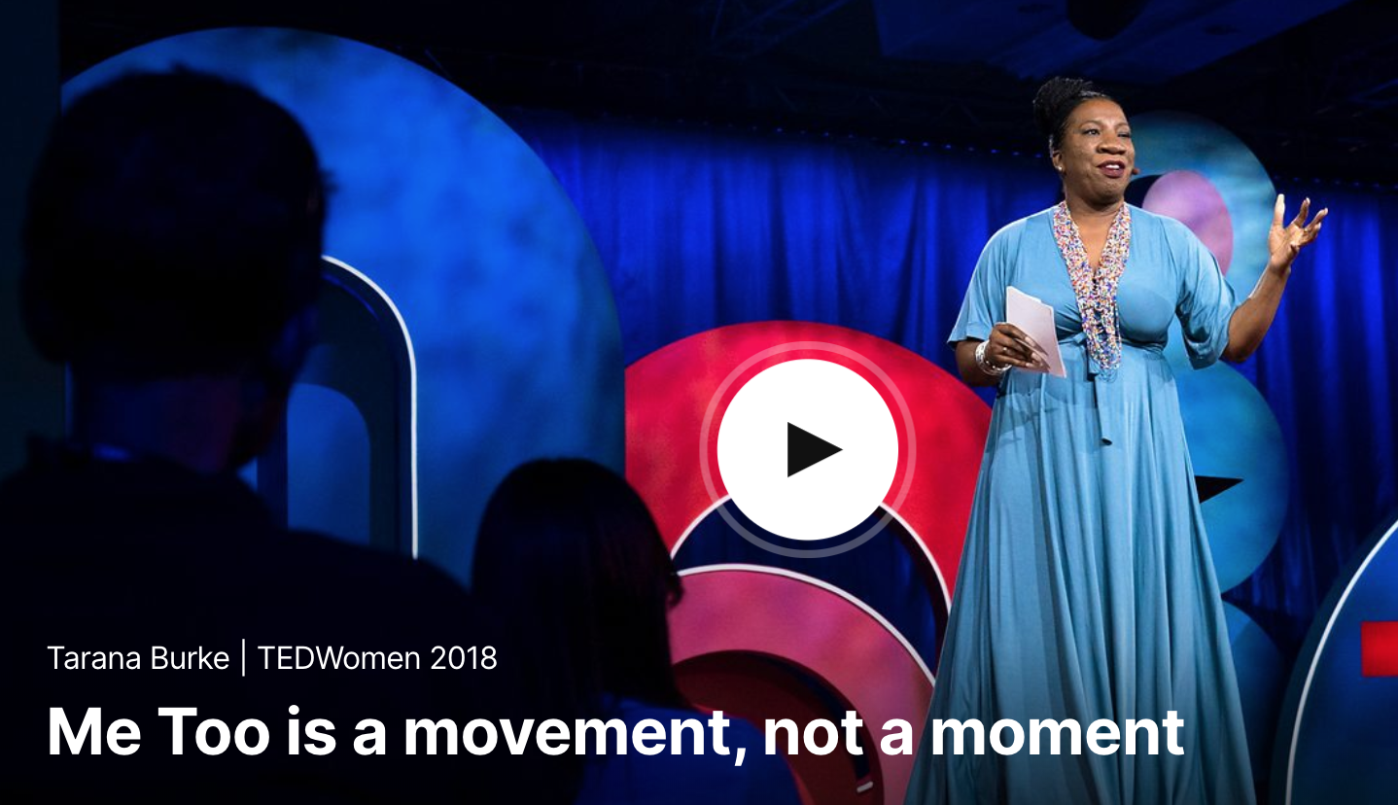
Chapter Six: Intersectional Approaches to Safety in Private Spaces
Tarana Burke, “Me Too is a Movement, Not a Moment,” filmed November 2018 in Palm Springs, California, TedWomen2018

Slide 32
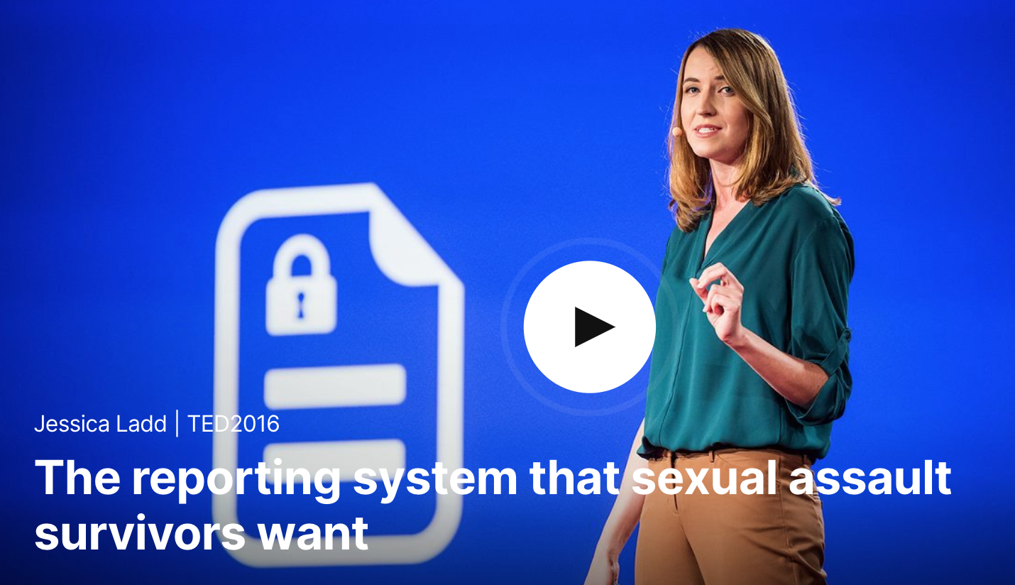
Chapter Six: Intersectional Approaches to Safety in Private Spaces
Jessica Ladd “The Reporting System that Sexual Assault Survivors Want,” filmed February 2016 in Vancouver, Canada, TED2016

Slide 33
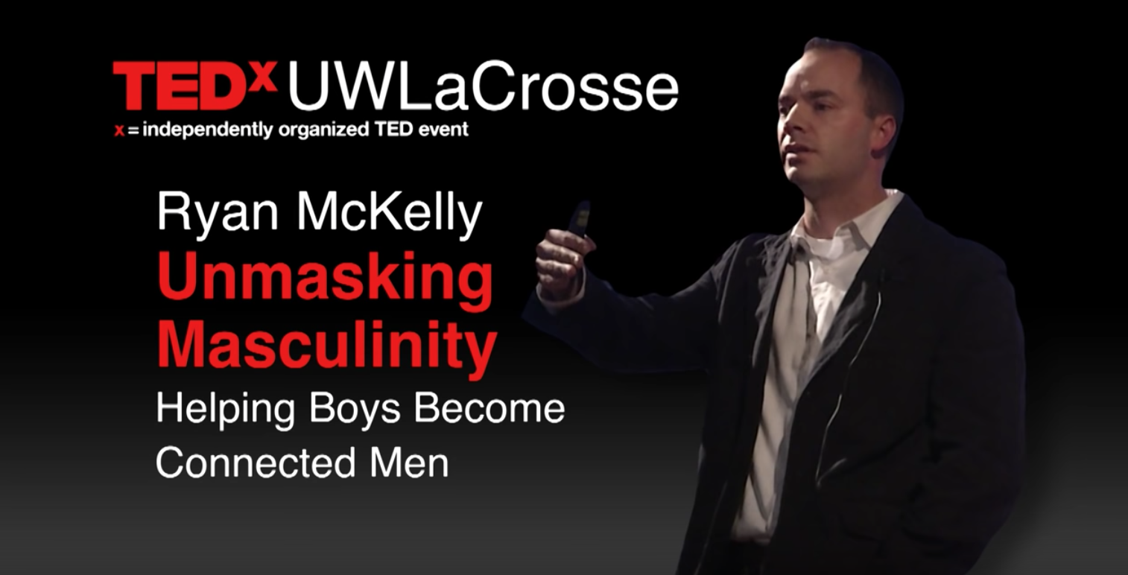
Chapter Six: Intersectional Approaches to Safety in Private Spaces
Ryan McKelley, “Unmasking Masculinity—Helping Boys Become Connected Men,” TEDxUWLaCrosse, filmed November, 26, 2013

