Slide 1
Beyond gender binaries
An Intersectional Orientation to Communication and Identities
CINDY L. GRIFFIN

Slide 2
Beyond Gender Binaries
Part I: Conceptual Foundations
Chapter 1: Intersectional Definitions of Identity and Communication
Chapter 2: Intersectional Explorations of Discourses of Rights
Chapter 3: Intersectional Approaches to Privilege and its Impact on Communication
Part II: Feminist Intersectional Orientations to Rights
Chapter 4: Intersectional Approaches to Personhood and Citizenship
Chapter 5: Intersectional Approaches to Safety in Public Spaces
Chapter 6: Intersectional Approaches to Safety in Private Spaces
Chapter 7: Intersectional Discourses for Talking About Sexual Violence
Chapter 8: Intersectional Approaches to Spaces for Learning
Chapter 9: Intersectional Approaches Workplace Injustices
Part III: Intersectionality and Structures of Power
Chapter 10: Hegemony and Structures of Power
Chapter 11: Discourses of Colonialism and Colonization
Chapter 12: Communicating Through Feminist and Intersectional Lenses

Slide 3
Beyond gender binaries
Part I: Conceptual Foundations
Chapter 1: Intersectional Definitions of Identity and Communication
Chapter 2: Intersectional Explorations of Discourses of Rights
Chapter 3: Intersectional Approaches to Privilege and its Impact on
Communication
CINDY L. GRIFFIN

Slide 4
Chapter One: Intersectional Definitions of Identity and Communication
Chapter Outline
In this chapter, you will find . . .
“The Danger of a Single Story”
What Is Intersectionality?
The Problems with Essentialist Thinking
The Benefits of Intersectional Thinking
What Is Communication?
Defining Communication Intersectionally
Communication and Hierarchies of Value
Discourse and Truth Regimes
Gender Identity: Communication Beyond Binaries
Invitational Rhetoric

Slide 5
Chapter One: Intersectional Definitions of Identity and Communication
Learning Objectives
After reading this chapter, you should be able to . . .
Evaluate relationships among our complex and nuanced identities.
Assess problematic logics in essentialist thinking.
Explain the importance of double (multiple) jeopardy and double (multiple) protections in the context of identity.
Analyze how hierarchies of value inform discourse.
Describe an intersectional orientation to communication.
Describe the benefits of invitational rhetoric

Slide 6
Chapter One: Intersectional Definitions of Identity and Communication
Benefits of Intersectional Thinking
Intersectionality Helps Us Avoid Essentialist Thinking
Intersectionality Calls Attention to Complexity and Multiplicity
Intersectionality Acknowledges Importance of Multiple Identities

Slide 7
Chapter One: Intersectional Definitions of Identity and Communication
Errors in the Logics Underlying Humanism
color-blind logic that says race, ethnicity, culture, and the color of one’s skin have no effect on how individuals are treated
cisgender logic that says that every person’s gender matches the biological body they were assigned at birth
heteronormative logic that says that all individuals possess the same sexuality—that is, everyone is, and should be, heterosexual
classist logic that says that economic conditions, opportunities, and resources are the same, or can be, for every person in a community or country
ableist logic that says that all bodies and minds function without obstacles or challenges, and that they should move about the world as though there are none

Slide 8
Chapter One: Intersectional Definitions of Identity and Communication
1.1 Guide to Communication: Developing an Intersectional Vocabulary
Consider the “Single Story” you may have heard about a group of people. This Single Story may be about people from a country other than your own or about people who live in your own country. What information does this story give you about those people? Have you taken the time or had the opportunity to discover whether or not this story reflects the complexity of the people it is about? If so, what can you add to the “Single Story” to increase its intersectionality? If not, log into TED and see if you can find those intersectional stories.
Sketch or draw an image of your view of intersectionality. Use the definition offered in this section as well as the material you have read and/or discussed as a class. Compare your view with several of your classmates. Discuss the similarities and differences in your views and images.
Consider your own identities through an intersectional lens and make a list of your various identities that you feel are significant—for you and others. Make a list of the times in the last week that those identities have made life easier or harder for you.
Make a list of the new vocabulary and ways of communicating you are developing. Consider whether there are terms and phrases you will no longer use, and whether there are new terms and phrases you will need to help you communicate about identity complexities.
Identify several current issues or events that have caught our national attention recently, or that have been a topic of controversy for some time. Using intersectionality as a tool, name the complexities inherent in that issue or event.

Slide 9
Chapter One: Intersectional Definitions of Identity and Communication
1.2 Guide to Communication: Discourse, Power and Agency
Make a list of the identities you avow to and another list of those that have been ascribed to you. Do not put your name on that list, yet. As a class, compile two lists: a list of the avowed identities of all the people in your class and another list of the ascribed identities.
What kind of “strong winds” are present for some of these identities, yet absent for others? Discuss the differences, hierarchies, and amount of agency and power in each of these lists.
Review the list of “Discourses of . . .” presented in this chapter. Now select a contemporary, and contentious, issue we face today. Map out the arguments around this issue and identify which discourse regimes they fall into. What kinds of claims emerge from these different truth regimes? What are the communication obstacles we face and in what ways might defining communication intersectionally help us communicate more effectively and less contentiously?

Slide 10
Chapter One: Intersectional Definitions of Identity and Communication
1.3 Guide to Communication: Nonbinary and Invitational Communication
Consider the nonbinary vocabulary you have been exposed to in this section. Identify the terms you would use to describe your own gender and sexual orientation. How often do you use these terms? Why do you or don’t you use them in conversation with other people?
How important do you feel these nonbinary terms are? If you wanted to have an invitational conversation about their importance with someone else, who felt different than you did about their importance, how might you begin that conversation? How would you stay invitational rather than argumentative throughout the conversation?

Slide 11
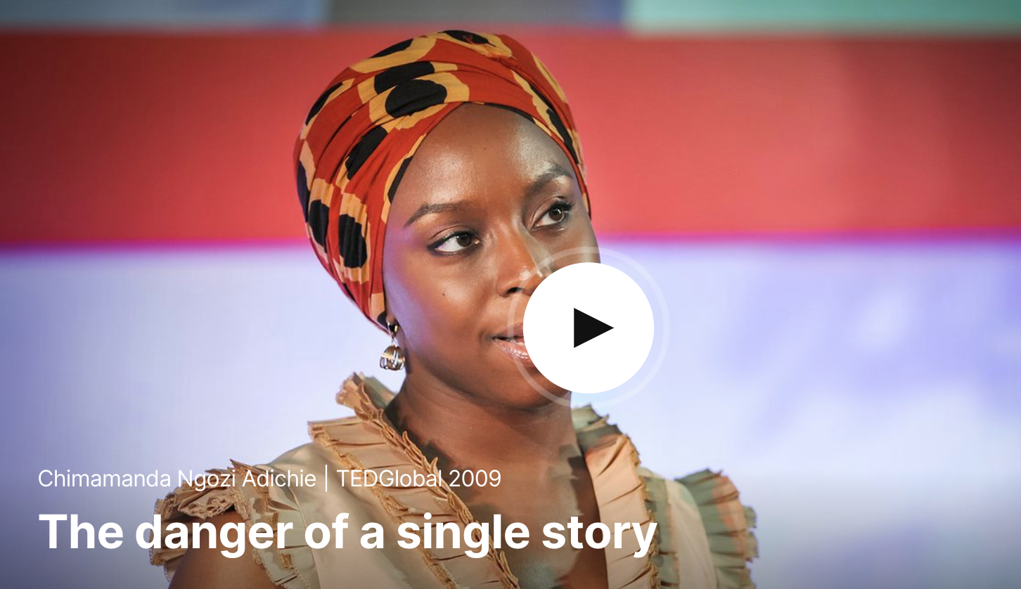
Chapter One: Intersectional
Definitions of
Identity and Communication
Chimamanda Adichie, “The Danger of a Single Story,” filmed July 2009 in Oxford, England, TEDGlobal video

Slide 12
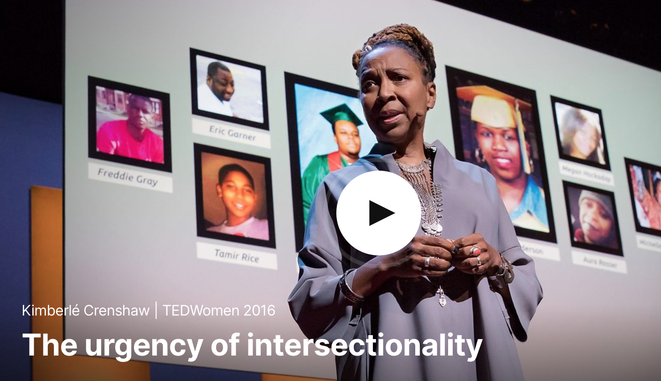
Chapter One: Intersectional
Definitions of
Identity and Communication
Kimberly Crenshaw and Abby Dobson, “The Urgency of Intersectionality,” filmed October 2016 in San Francisco, California, TEDWomen video

Slide 13
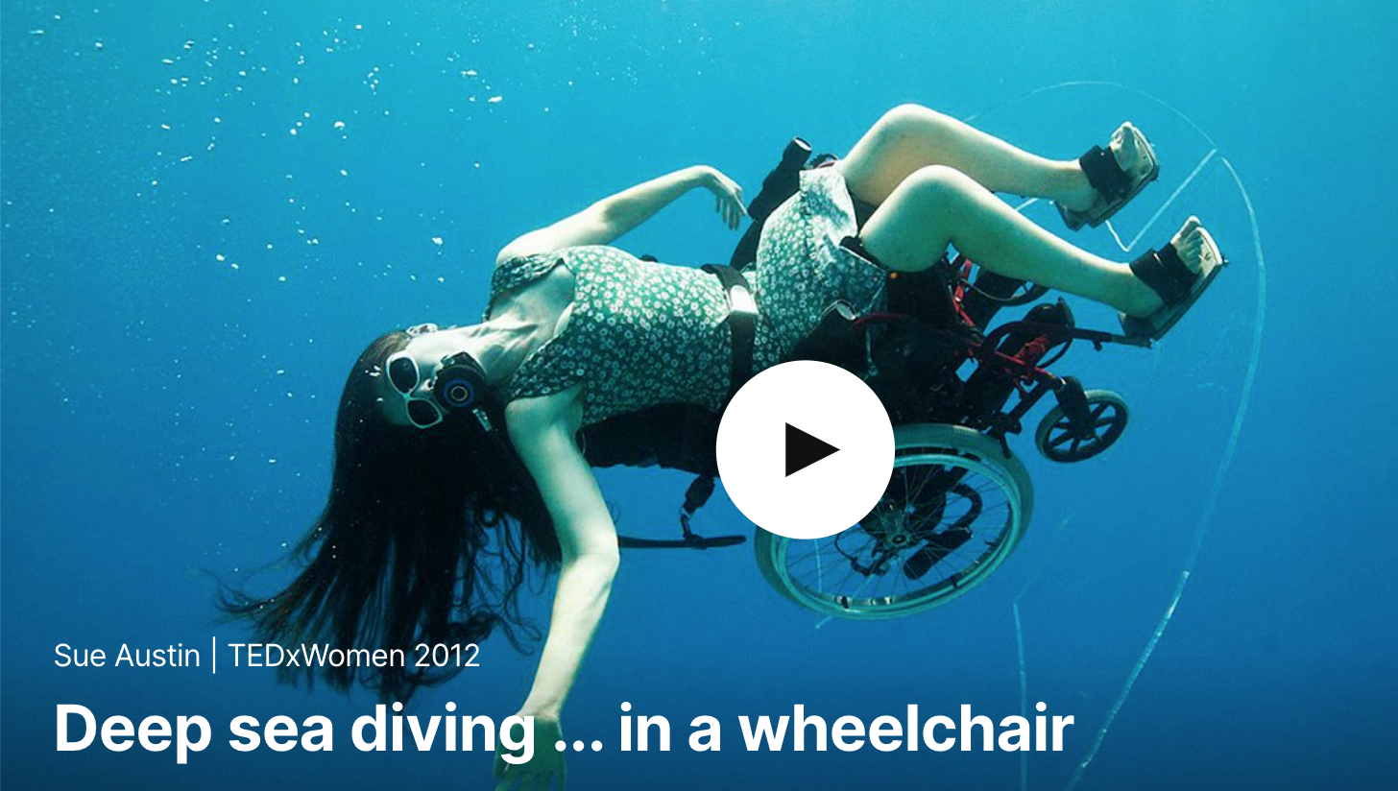
Chapter One: Intersectional
Definitions of
Identity and Communication
Sue Austin, “Deep Sea Diving . . . In a Wheel Chair,” filmed November 2012 in Washington, DC, TEDWomen video

Slide 14
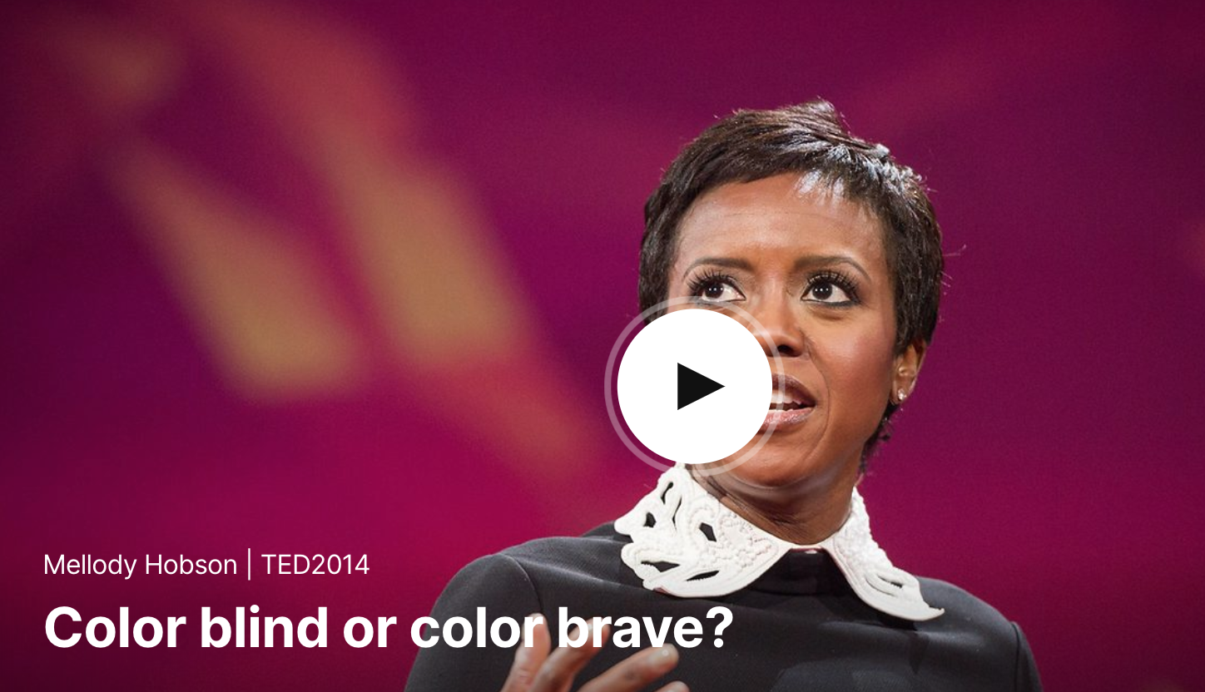
Chapter One: Intersectional
Definitions of
Identity and Communication
Melody Hobson, “Color Blind or Color Brave,” filmed March 2014 in Vancouver, BC, Canada, TED2014 video

Slide 15
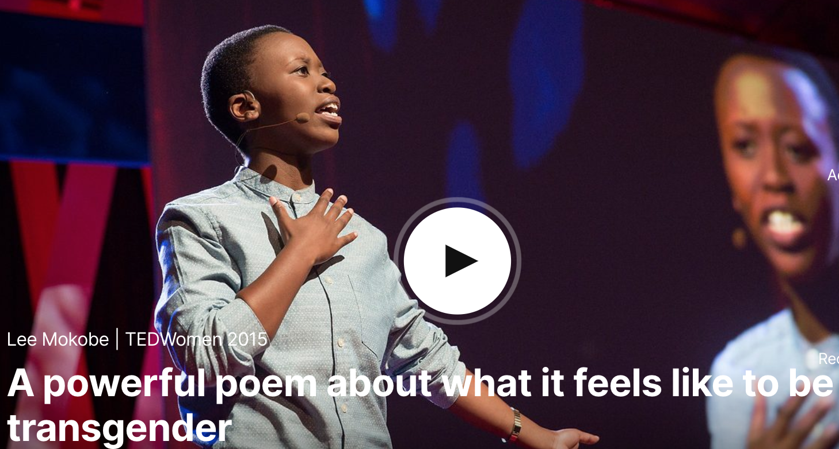
Chapter One: Intersectional
Definitions of
Identity and Communication
Lee Mokobe, “A Powerful Poem About What It Feels Like to Be Transgender,” filmed in May 2015 in Monterrey, California, TEDWomen 2015 video

Slide 16
Chapter Two: Intersectional Explorations of Discourses of Rights
Chapter Outline
In this chapter, you will find . . .
“Gender Equality Is Your Issue, Too”
Feminism and Discourses of Rights
First Wave
Second Wave
Third Wave
Patriarchy and Discourses of Rights
The American Dream and Promises Made
Entitlement and the Loss of a Birthright
From Entitlement to Outrage
Intersectionality and Discourses of Rights

Slide 17
Chapter Two: Intersectional Explorations of Discourses of Rights
Learning Objectives
After reading this chapter, you should be able to . . .
Define feminism.
Describe the accomplishments and the evolution of first wave, second wave, and third wave feminism.
Define patriarchy.
Identify the ways patriarchy, as a political system, perpetuates certain discourses of rights.
Assess the American Dream, the promises made by this Dream, and the ways those promises can lead to entitlement and outrage.
Apply an intersectional vocabulary to discourses of rights

Slide 18
Chapter Two: Intersectional Explorations of Discourses of Rights
2.1 Guide to Communication: Exploring Intersectional Feminist Discourses of Rights
There likely are other things you have learned or heard about feminism and feminist movement not presented in this section. As a class, make a list of these other ways of thinking about feminism. Where does this knowledge come from? Whose perspective is being presented? Is this information oriented toward intersectional thinking?
Search for descriptions and images of fourth wave feminism. Who are the spokes people? What are they suggesting? How does this emerging fourth wave add to the conversation about intersectional approaches to gender equality?

Slide 19
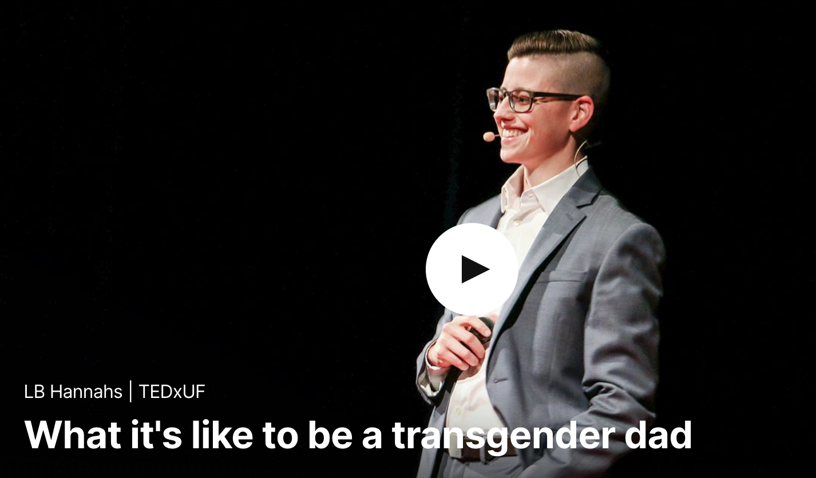
Chapter Two: Intersectional Explorations of Discourses of Rights
2.1 Guide to Communication: Exploring Intersectional Feminist Discourses of Rights
Watch L.B. Hannahs, “What it’s Like to be a Trans Gender Dad,” filmed April 2017 in Gainesville, Florida, TEDxUF video

Slide 20
Chapter Two: Intersectional Explorations of Discourses of Rights
2.2 Guide to Communication: Moving Beyond Outrage
Discuss the American Dream with other students in your class. Develop a list of the promises made in this Dream. Bring the Declaration of Independence and the Constitution into your discussion if you think they will help you understand this Dream.
Once you have a strong idea of what the American Dream promises, identify the sources of that dream—that is, how has it been communicated to us? Identify as many sources as you can: news, politics, public and private institutions, people, stories, movies, music, and the like. How often are we exposed to this dream?
bell hooks provides a complex definition of patriarchy. Take time in class to explore this definition carefully, honestly, and respectfully. If you are uncomfortable with her definition, consider why. Write one of your own, or amend her definition, so that you think it describes patriarchy more accurately.

Slide 21
Chapter Two: Intersectional Explorations of Discourses of Rights
2.2 Guide to Communication: Moving Beyond Outrage
Collect examples of outrage discourse from a variety of sources and perspectives (that is, the “left,” and the “right” as well as other “positions”). Bring these to class and share them or post them so that you can discuss them with your fellow students (the citation for the article in this chapter is Sarah Sobieraj and Jeffrey M. Berry, “From Incivility to Outrage: Political Discourse in Blogs, Talk Radio and Cable News,” Political Communication, 28 (2011), DOI: 10.1080/10584609.2010.542360, and you can find it online from your library). What types of outrage are you seeing in the examples you are exploring? Pretend that you are either the sender of the outrage and that you wanted to communicate with the person you were outraged at. How might you do so? Now pretend you are the receiver of the outrage and wanted to communicate with the sender; how might you do so?

Slide 22
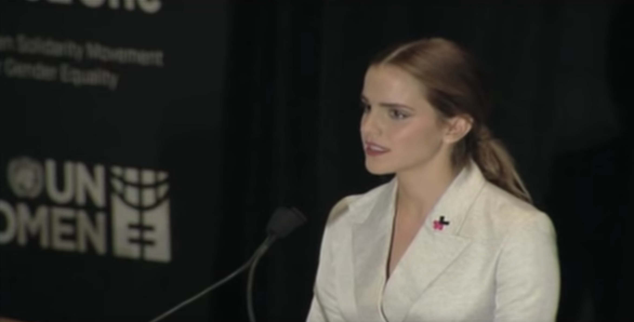
Chapter Two: Intersectional Explorations of Discourses of Rights
Emma Watson, “Emma Watson HeForShe Speech at the United Nations | UN Women 2014,”filmed September 22, 2014 in New York, New York, YouTube video

Slide 23
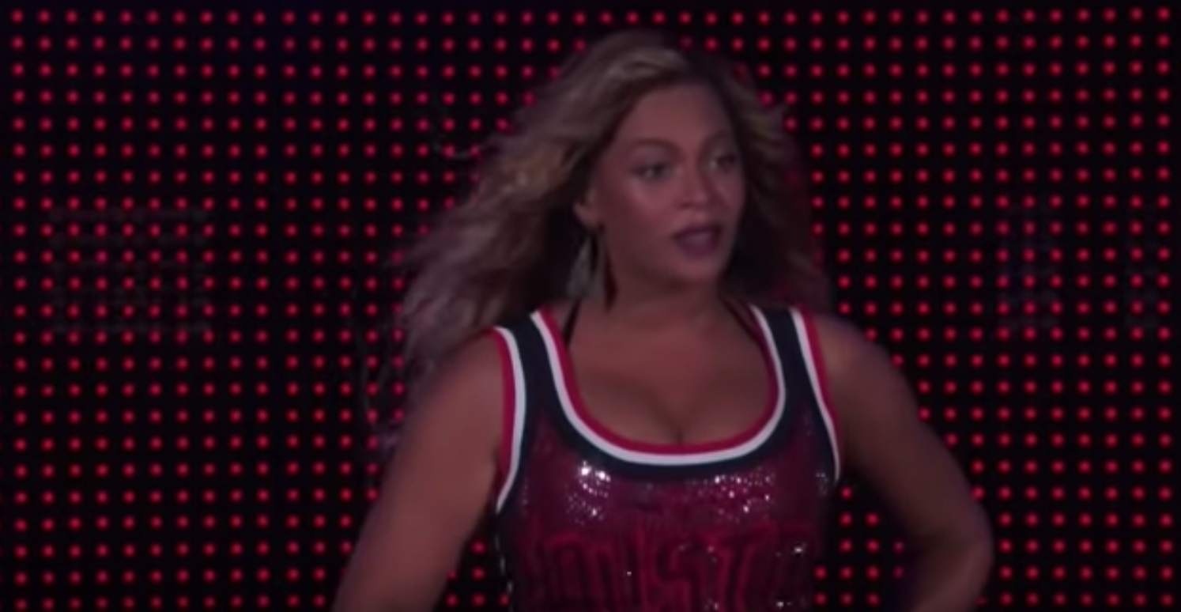
Chapter Two: Intersectional Explorations of Discourses of Rights
Beyoncé, “Beyoncé - Flawless (HD) Live global citizen festival,” filmed September 26, 2105 in New York, NY

Slide 24
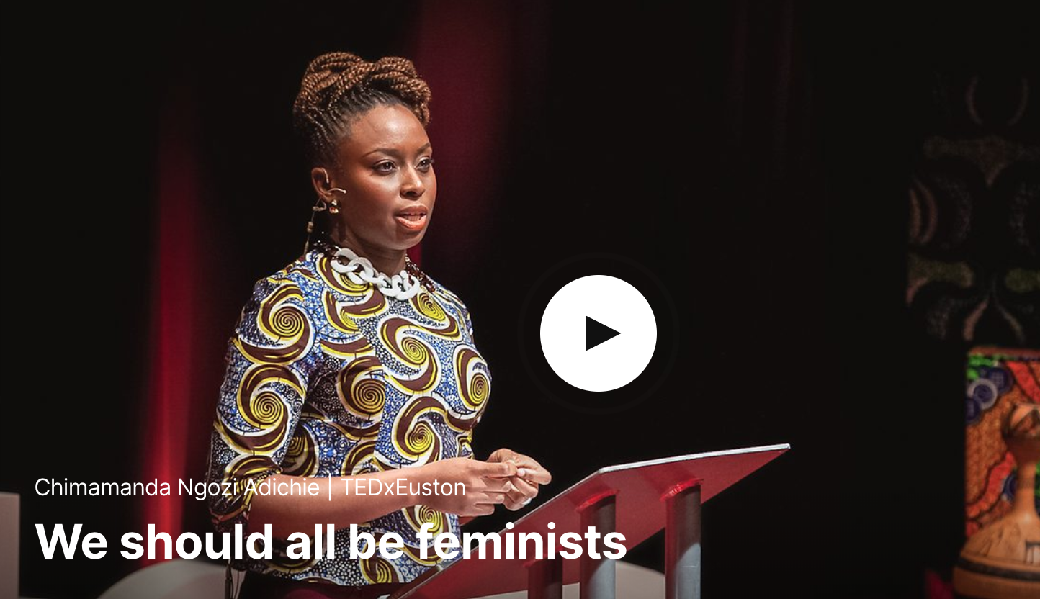
Chapter Two: Intersectional Explorations of Discourses of Rights
Chimamanda Adichie, “Why We Should All Be Feminists,” filmed December 2012 in London, England, TEDxEuston video

Slide 25
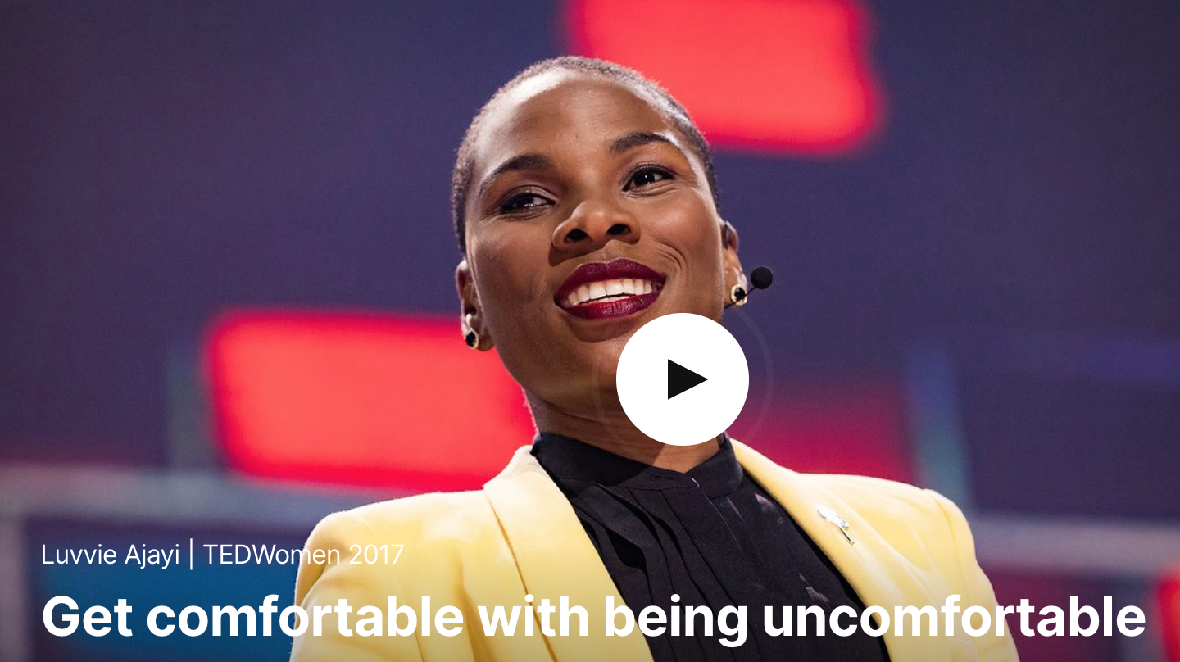
Chapter Two: Intersectional Explorations of Discourses of Rights
Luvvie Ajayi, “Get Comfortable with Being Uncomfortable,” filmed November 2017 in New Orleans, Louisiana, TEDWomen video

Slide 26
Chapter Three: Intersectional Approaches to Privilege and its Impact on Communication
Chapter Outline
In this chapter, you will find . . .
Asking Intersectional Questions
Privilege as a Kaleidoscope of Unmarked Advantages
Unearned Privileges
Unpacking Your Own Invisible Knapsack and Improving Communication
Individual and Collective Guilt
Privilege and the Aesthetics of Human Disqualification
Disqualification and Phobias
Unmasking Phobias
The Possibility of Alliances and Coalitions
An Intentional Loss of Innocence

Slide 27
Chapter Three: Intersectional Approaches to Privilege and its Impact on Communication
Learning Objectives
After reading this chapter, you should be able to . . .
Evaluate the kaleidoscope of privileges that are available, and also denied, to individuals based on a variety of identity categories.
Explain guilt vs. responsibility and difference between individual and collective guilt.
Assess the ways in which hierarchies of power perpetuate or challenge racism, sexism, homophobia and transphobia, classism, and ableism.
Create an intersectional framework for feminist, multiracial, multicultural, and international coalition building.

Slide 28
Chapter Three: Intersectional Approaches to Privilege and its Impact on Communication
3.1 Guide to Communication: The Language of Privilege
Take a moment to review your scores on the privilege quizzes. Select one or two of the quizzes and consider how this information may change how you interact with the people around you. You can use the following questions to help you develop an intersectional approach to communication:
What privileges do I have that might be influencing my interactions with others?
What privileges don’t I have that might be influencing my interactions with others?
Given the privileges that are present and/or absent in my knapsack, what are my communication challenges?
What new information do I need to assist me in working respectfully and openly through these challenges?

Slide 29
Chapter Three: Intersectional Approaches to Privilege and its Impact on Communication
3.2 Guide to Communication: An Intentional Loss of Innocence
As you conclude this section on human disqualification, phobias, and power lines, consider all that you have been exposed to and asked to digest. To improve your communication with other people, ask yourself the following questions:
In what ways do I engage discourses that disqualify other people?
What phobias do I possess and what hierarchies do they depend on?
How might my beliefs in “nonquality human beings” be affecting my ability to listen and communicate with other people?
Are there alliances and coalitions I might be willing to create and establish that could help me understand the complexity of identity and the illusion of “normal”?

Slide 30
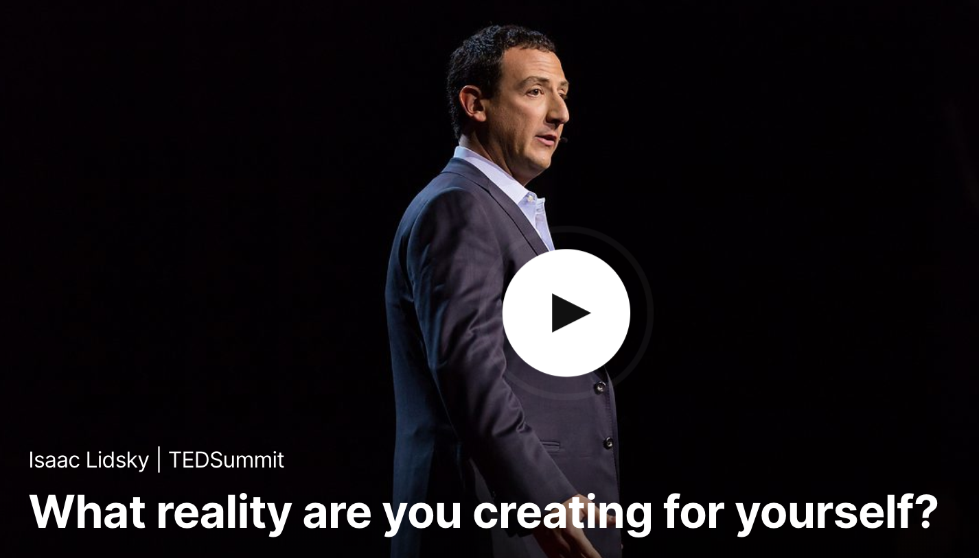
Chapter Three: Intersectional Approaches to Privilege and its Impact on Communication
Issac Lidsky, “What Reality are you Creating for Yourself?” filmed June 2016 in Banf, Alberta, Canada, TEDSummit video

Slide 31
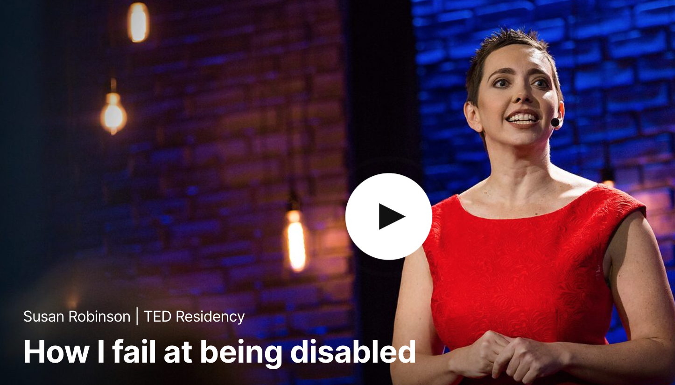
Chapter Three: Intersectional Approaches to Privilege and its Impact on Communication
Susan Robinson, “How I Fail at Being Disabled,” filmed December 2016 in New York, New York, TED Residency video

Slide 32
Chapter Three: Intersectional Approaches to Privilege and its Impact on Communication
Luvvie Ajayi, “Get Comfortable with Being Uncomfortable,” filmed November 2017 in New Orleans, Louisiana, TEDWomen video

Slide 33
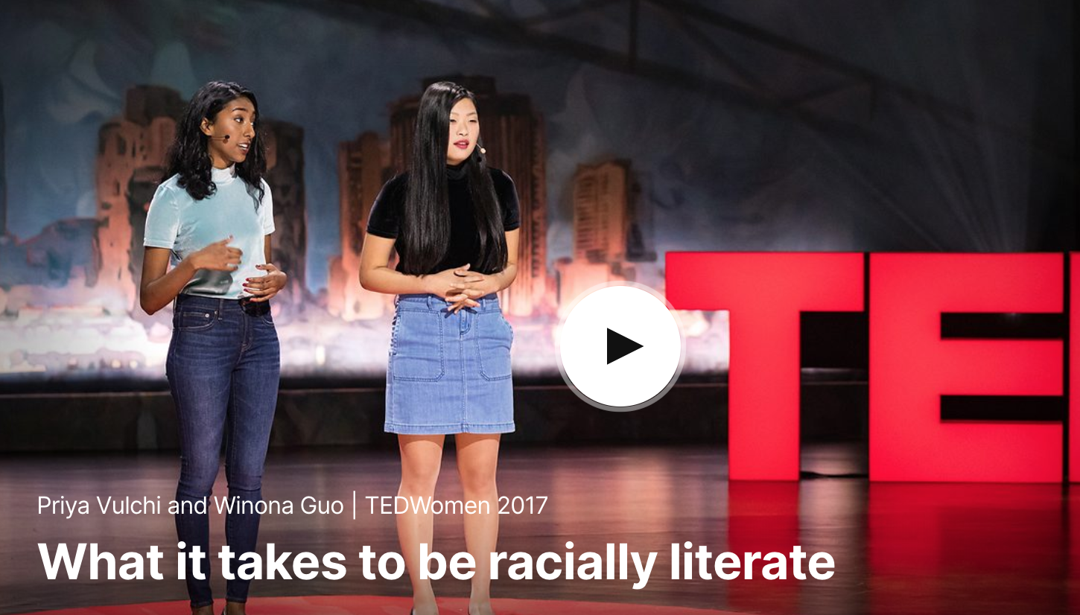
Chapter Three: Intersectional Approaches to Privilege and its Impact on Communication
Priya Vulchi and Winona Guo, “What it takes to be Racially Literate,” Filmed November 2017 in New Orleans, Louisiana, TEDWomen video

