Slide 1
CINDY L. GRIFFIN
Beyond Gender Binaries
Part II(b): Feminist Intersectional Orientations to Rights
Chapters 7-9
Notes:
Source: User-provided PDF, page 1.
BEYOND GENDER BINARIES
Part II (b): Feminist Intersectional Orientations to
Rights
Chapter 7: Intersectional Discourses for Talking About Sexual Violence
Chapter 8: Intersectional Approaches to Spaces for Learning
Chapter 9: Intersectional Approaches Workplace Injustices
CINDY L. GRIFFIN

Slide 2
Chapter Seven: Intersectional Discourses for Talking About Sexual Violence
Chapter Outline
• In this chapter, you will find . . .
Discourses of Public Cruelty
Communication and The Burden of Performance
Communication and The Burden of Credibility
Communication and The Burden of Silence
Communication and The Burden of Ability
Communication About the Perpetrators: Forces Beyond their Control
Communication from the Perpetrators: “Legitimate Forms of Humiliation”
Stories of Resilience and Resistance
• On College Campuses
• In Social Settings
• In Communities
• On the Street
• In Free Trade Zones
The Power of Community
Notes:
Source: User-provided PDF, page 2.
Chapter Seven: Intersectional Discourses
for Talking About Sexual Violence
Chapter Outline
➢ In this chapter, you will find . . .
Discourses of Public Cruelty
Communication and The Burden of Performance
Communication and The Burden of Credibility
Communication and The Burden of Silence
Communication and The Burden of Ability
Communication About the Perpetrators: Forces Beyond their Control
Communication from the Perpetrators: “Legitimate Forms of Humiliation”
Stories of Resilience and Resistance
➢ On College Campuses
➢ In Social Settings
➢ In Communities
➢ On the Street
➢ In Free Trade Zones
The Power of Community

Slide 3
Chapter Seven: Learning Objectives
Learning Objectives
After reading this chapter, you should be able to . . .
• Assess the unequal burdens of communication placed on victims-survivors.
• Analyze how the grammar of non-agency and the aura of non-responsibility are
used to exonerate perpetrators.
• Describe the ways a response-able witness can counter prevalent assumptions
about sexual assault.
• Create alternative narratives of resilience and resistance that circumvent the
structures of power and privilege that keep victims-survivors silenced.
Notes:
Source: User-provided PDF, page 3.
Chapter Seven: Intersectional Discourses
for Talking About Sexual Violence
Learning Objectives
After reading this chapter, you should be able to . . .
➢ Assess the unequal burdens of communication placed on victims-survivors.
➢ Analyze how the grammar of non-agency and the aura of non-responsibility are
used to exonerate perpetrators.
➢ Describe the ways a response-able witness can counter prevalent assumptions
about sexual assault.
➢ Create alternative narratives of resilience and resistance that circumvent the
structures of power and privilege that keep victims-survivors silenced.

Slide 4
Categories of Non-Agency and Non-Responsibility: Part 1
Category | Excuse | Why invalid
Alcohol and drug abuse | His abuse eroded his inhibitions and made him act out of character. | Most men do not assault women sexually when intoxicated or under the influence of drugs.
Sexual drive | His lack of sexual fulfillment was a precipitating factor. | Equating sexualized assault with sexual activity conceals violence and treats the act as mutual.
Psychopathology | He was reacting to a pre-existing psychological disorder. | This minimizes the violence and suggests that the offender was simply indulging a biological need.
Dysfunctional family upbringing | His damaged family background caused the assault. | This makes violence seem inevitable and shifts responsibility from the individual to the past.
Notes:
Source: User-provided PDF, page 4.
Category Excuse Why Invalid
Alcohol and drug His abuse eroded The majority of men do not assault women Chapter Seven:
abuse his inhibitions and sexually when intoxicated or under the
made him act out influence of drugs.
Intersectional
of character. Discourses for
Sexual drive His lack of sexual Making sexualized assault synonymous Talking About
fulfillment was a with sexual activity conceals the violence,
precipitating casts the act as mutual, and “is Sexual Violence
factor. analogous” to the “idea that someone can
fulfill his need for positive social affiliation
by assaulting people.” Categories of Non-Agency/
Psychopathology He was just Possessing a psychopathology minimizes Non-Responsibility
reacting to a pre- the violence and casts the offender as
existing “indulging in his needs,” suggesting a
(Part 1)
psychological “biological requirement that must be met
disorder. in order to survive”—like breathing.
Dysfunctional His damaged A dysfunctional family explains the violence
family upbringing family background as inevitable and reduces the responsibility
caused the of the individual by placing the blame on
assault. his past rather than on him.

Slide 5
Categories of Non-Agency and Non-Responsibility: Part 2
Category | Excuse | Why invalid
Trauma and stress | Family pressure, combat experiences, and external stresses caused the behavior. | This treats violence as a result of prior trauma rather than a deliberate act.
Character traits | The offender is a violent person and had no choice but to behave violently. | Treating violence as an inborn nature assumes the person cannot act differently.
Emotion | Overwhelming emotions, such as anger, caused the assault. | This denies the deliberateness and seriousness of assaults that are often premeditated.
Loss of control | He did not intend to hurt them. Things just got out of hand. | This denies deliberateness and recasts harmful behavior as something the perpetrator could not help.
Notes:
Source: User-provided PDF, page 5.
Category Excuse Why Invalid
Trauma and Family pressures, combat Using past trauma and stress as an
stress experiences, and external explanation for the violence casts the acts
stresses caused behavior. as occurring because of prior trauma Chapter Seven:
rather than something he did deliberately,
even in light of a past trauma.
Intersectional
Discourses for
Character The offender is a violent Essentializing an offender as violent by Talking About
traits person, he had no choice but nature requires that we ask the question,
to behave violently. “Can a person act in a way contrary to his Sexual Violence
or her nature?” and answer it with, no, he
cannot.
Emotion His experience of Ascribing overwhelming emotion as the Categories of Non-Agency/
overwhelming emotions, cause of violence denies the Non-Responsibility
such as anger, caused the deliberateness and seriousness of what
assault. are, in fact, premeditated assaults. (Part 2)
Loss of He didn't intend to hurt them, Attributing violent behaviors to a loss of
control things just got out of hand. control or things “getting out of hand,”
even as the victim is a small child, denies
the deliberateness and seriousness of the
assault. “Difficulty controlling” ones own
behavior becomes “he didn’t intend to hurt
them,” he just “could not help himself.”
Source: Linda Coates and Allan Wade, “Telling It Like It Isn’t: Obscuring Perpetrator Responsibility for Violent Crime,” Discourse & Society 15 no. 5 (2004): 507-514.

Slide 6
Guide to Communication: Sexual Violence and Intersectional Literacy
7.1 Guide to Communication: Sexual Violence and Intersectional Literacy
Developing an intersectional vocabulary around the topic of sexual violence can feel quite
challenging. To assist you in developing this new vocabulary, try the following:
1. Over several weeks, explore how fluent are you in the intersectional language of sexual
violence. To do this, listen for the non-intersectional language of burden, credibility, silence,
and ability in media, group or interpersonal conversations, and even in your own language.
Record the specific words and phrases that make this discourse about sexual violence non-
intersectional. If you wanted to speak intersectionally about sexual violence, how might you
reframe these conversations?
2. Consider the approaches to resistance you have learned about in this chapter (telling stories
of successful resistance, stigmatizing sexual violence, engaging bystanders, reporting and
responding, building community, sharing histories, and educating people). Do you already
engage in some of these acts of resistance? Are there others you would like to participate
in? To whom do you or would your direct your messages—who is or would your audience be?
What is your message? Are there other forms of resistance you have seen, or would like to
engage, as you tell an intersectional story about sexual violence?
Notes:
Source: User-provided PDF, page 6.
Chapter Seven: Intersectional Discourses
for Talking About Sexual Violence
7.1 Guide to Communication: Sexual Violence and Intersectional Literacy
Developing an intersectional vocabulary around the topic of sexual violence can feel quite
challenging. To assist you in developing this new vocabulary, try the following:
1. Over several weeks, explore how fluent are you in the intersectional language of sexual
violence. To do this, listen for the non-intersectional language of burden, credibility, silence,
and ability in media, group or interpersonal conversations, and even in your own language.
Record the specific words and phrases that make this discourse about sexual violence non-
intersectional. If you wanted to speak intersectionally about sexual violence, how might you
reframe these conversations?
2. Consider the approaches to resistance you have learned about in this chapter (telling stories
of successful resistance, stigmatizing sexual violence, engaging bystanders, reporting and
responding, building community, sharing histories, and educating people). Do you already
engage in some of these acts of resistance? Are there others you would like to participate
in? To whom do you or would your direct your messages—who is or would your audience be?
What is your message? Are there other forms of resistance you have seen, or would like to
engage, as you tell an intersectional story about sexual violence?

Slide 7
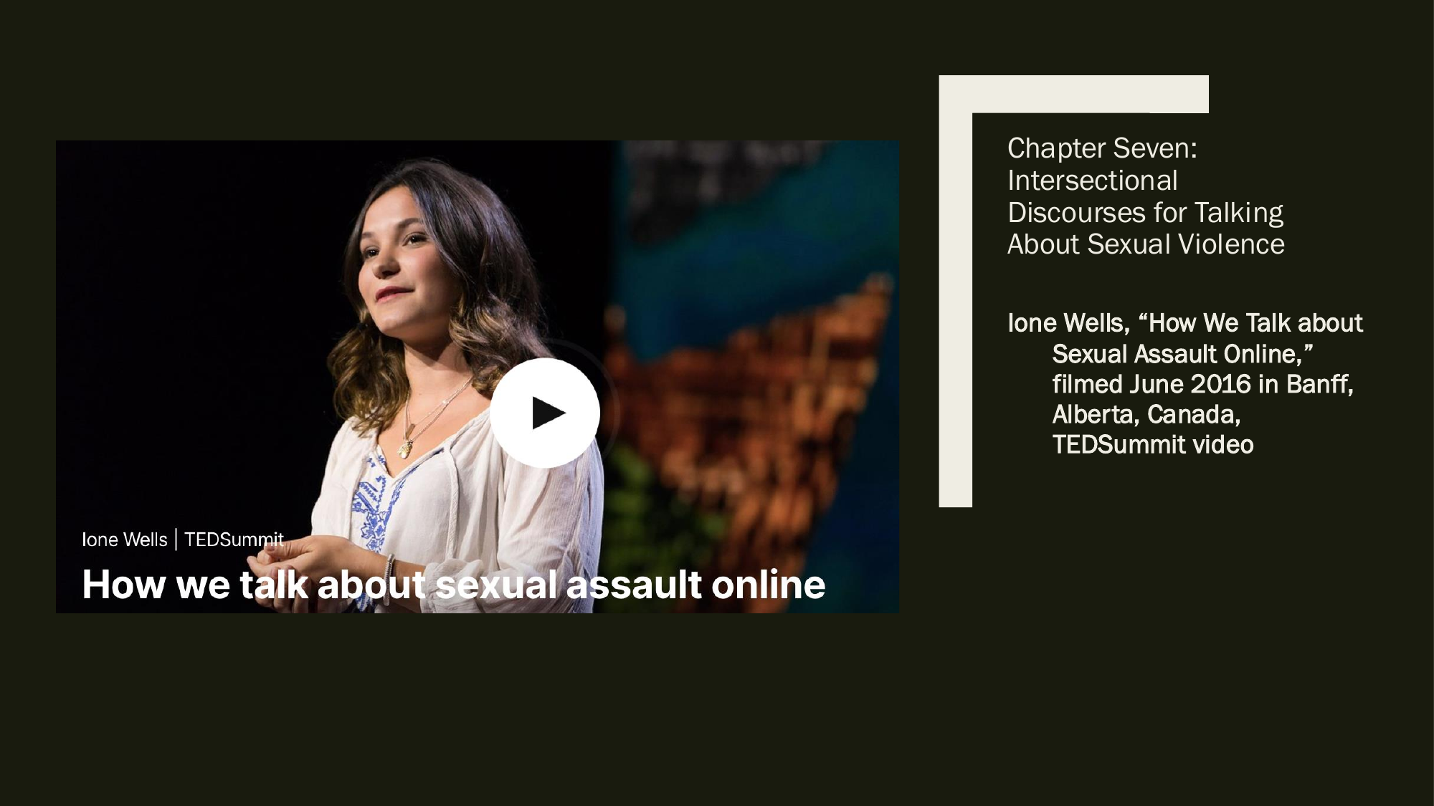
Ione Wells: How We Talk About Sexual Assault Online
Ione Wells, “How We Talk about Sexual Assault Online,” filmed June 2016 in Banff, Alberta, Canada, TEDSummit video
Resource referenced in the chapter materials
Notes:
Source: User-provided PDF, page 7.
Chapter Seven:
Intersectional
Discourses for Talking
About Sexual Violence
Ione Wells, “How We Talk about
Sexual Assault Online,”
filmed June 2016 in Banff,
Alberta, Canada,
TEDSummit video

Slide 8
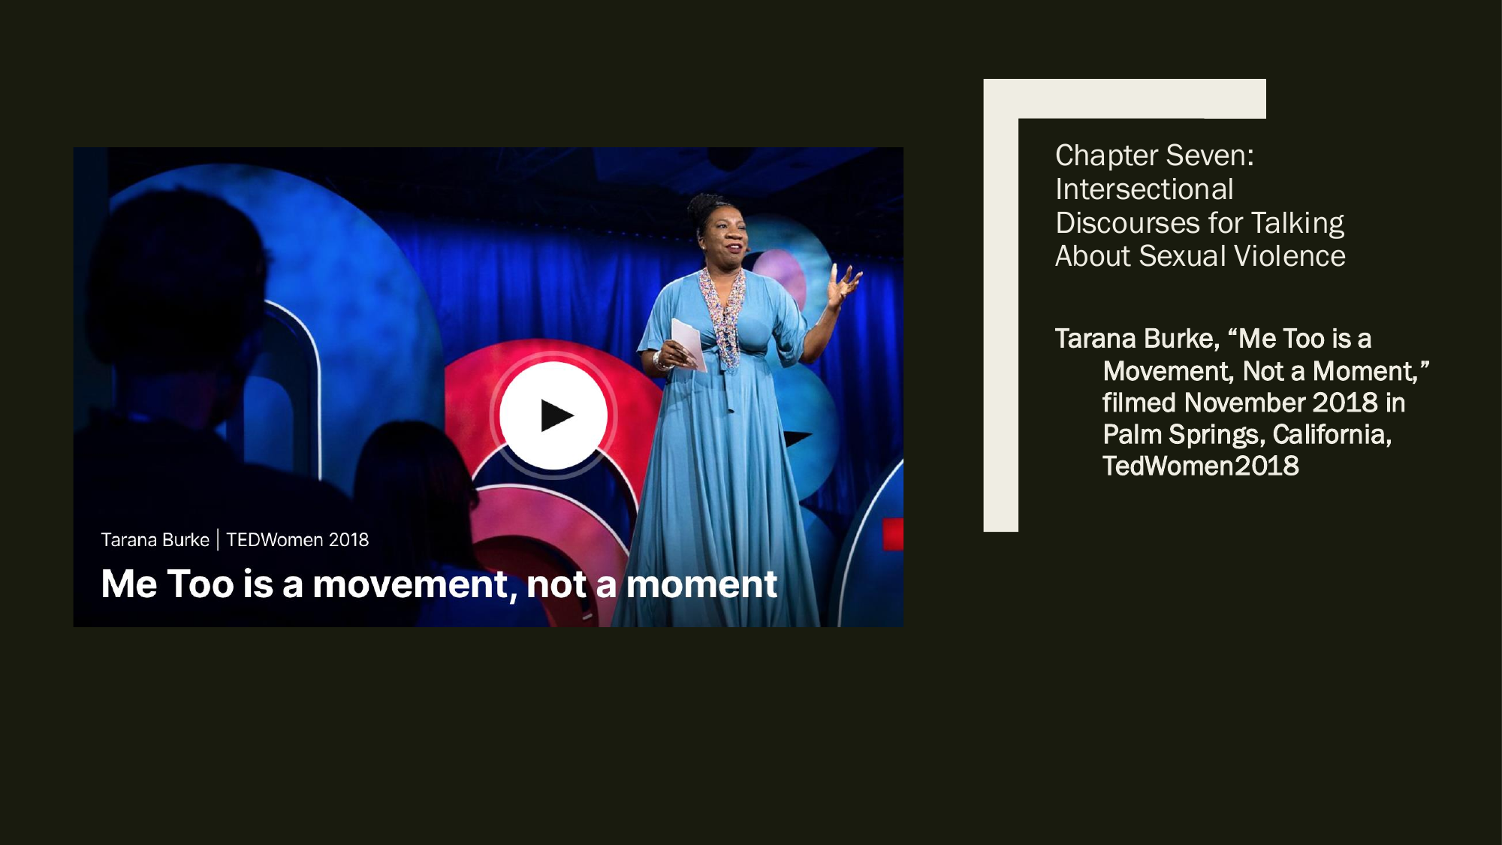
Tarana Burke: Me Too Is a Movement, Not a Moment
Tarana Burke, “Me Too is a Movement, Not a Moment,” filmed November 2018 in Palm Springs, California, TEDWomen 2018 video
Resource referenced in the chapter materials
Notes:
Source: User-provided PDF, page 8.
Chapter Seven:
Intersectional
Discourses for Talking
About Sexual Violence
Tarana Burke, “Me Too is a
Movement, Not a Moment,”
filmed November 2018 in
Palm Springs, California,
TedWomen2018

Slide 9
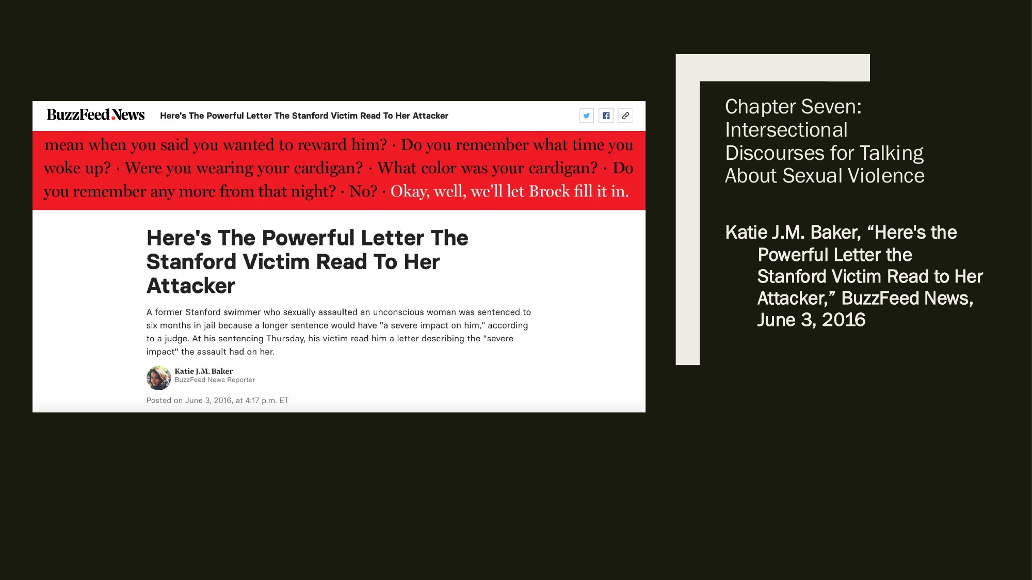
Stanford Victim Impact Statement
Katie J.M. Baker, “Here’s the Powerful Letter the Stanford Victim Read to Her Attacker,” BuzzFeed News, June 3, 2016
Resource referenced in the chapter materials
Notes:
Source: User-provided PDF, page 9.
Chapter Seven:
Intersectional
Discourses for Talking
About Sexual Violence
Katie J.M. Baker, “Here's the
Powerful Letter the
Stanford Victim Read to Her
Attacker,” BuzzFeed News,
June 3, 2016

Slide 10
Chapter Eight: Intersectional Approaches to Spaces for Learning
Chapter Outline
to Spaces for Learning
• In this chapter, you will find . . .
The Right to Safety in Our Schools
Bullying
• Who Bullies and Who Gets Bullied?
• Bullying: Real Time and Online Patterns
• Mass Shootings: Yesterday and Today
• Violence is Synonymous with Masculinity
Microaggressions
• Defining Microaggressions
• Examples of Microaggressions
Non-Binary Pronouns
The Right to Learn
• Title IX, Civil Rights Act, and Americans with Disabilities Act: No
Exclusions
• Curriculum Matters
Rejecting Discourses of Supremacy
Notes:
Source: User-provided PDF, page 10.
Chapter Eight: Intersectional Approaches
Chapter Outline
to Spaces for Learning
➢ In this chapter, you will find . . .
The Right to Safety in Our Schools
Bullying
➢ Who Bullies and Who Gets Bullied?
➢ Bullying: Real Time and Online Patterns
➢ Mass Shootings: Yesterday and Today
➢ Violence is Synonymous with Masculinity
Microaggressions
➢ Defining Microaggressions
➢ Examples of Microaggressions
Non-Binary Pronouns
The Right to Learn
➢ Title IX, Civil Rights Act, and Americans with Disabilities Act: No
Exclusions
➢ Curriculum Matters
Rejecting Discourses of Supremacy

Slide 11
Chapter Eight: Learning Objectives
Learning Objectives
After reading this chapter, you should be able to . . .
• Describe the importance of feeling safe in learning environments.
• Identify those most vulnerable to bullying and violence in real time as well as online.
• Describe the perpetrators of real-time and online bulling and violence.
• Explain who the perpetrators of public mass murder in the United States are and the
reasons these perpetrators may be committing this violence.
• Define microaggressions and describe their impact on the targets of this form of
aggression.
• List the non-binary pronouns available to those who wish to use a intersectional
approach to identifying other people.
• Explain several of the reasons people with privilege avoid talking about that privilege.
Notes:
Source: User-provided PDF, page 11.
Chapter Eight: Intersectional Approaches
to Spaces for Learning
Learning Objectives
After reading this chapter, you should be able to . . .
➢ Describe the importance of feeling safe in learning environments.
➢ Identify those most vulnerable to bullying and violence in real time as well as online.
➢ Describe the perpetrators of real-time and online bulling and violence.
➢ Explain who the perpetrators of public mass murder in the United States are and the
reasons these perpetrators may be committing this violence.
➢ Define microaggressions and describe their impact on the targets of this form of
aggression.
➢ List the non-binary pronouns available to those who wish to use a intersectional
approach to identifying other people.
➢ Explain several of the reasons people with privilege avoid talking about that privilege.

Slide 12
Communication Checklist for Inclusive Language
Communication Checklist for Inclusive Language
✓ Put People First: focus on the person, not their characteristics, e.g., instead of “a blind woman” or “a woman
salesperson,” use “a woman who is blind” or “a woman on our sales team.”
✓ Use Gender Neutral Language: Using “guys” to address all people is gendered language that may insinuate
that men are preferred. Instead, work in inclusive words such as friends, folks, people, you all, y’all, and team,
and avoid terms that connote gender or are condescending, such as Man (Man Hours, Man Power),
Girls/Ladies/Gals/Females (could feel condescending; use women).
✓ Use Last Names: Women are often referred to as Mary when the male counterpart is Mr. Smith. Be neutral
in presentations, for example, or in written work and use last names to refer to both women and men.
✓ Ask About Preferred Pronouns: It’s simple, What pronouns do you prefer? PGPs include “he/she,” “they,”
“ze,” “per” and many others.
✓ Be Aware of Stigmatizing or Shaming Phrases: Mental Disability/Handicap (focus instead on the person,
Jeremiah has autism… rather than Jeremiah has a mental disability or is Autistic or handicapped), Bossy
(condescending when referring to a woman; use powerful, assertive, take-charge); Ghetto (a bigoted term
unflatteringly connoting nonwhite), Gypped (a racial slur, from “gypsy [a slur for Romani people]), Fat (negative
terms can feel shaming; use body positive descriptors that are neutral like large, big, robust).
Notes:
Source: User-provided PDF, page 12.
Chapter Eight: Intersectional Approaches
to Spaces for Learning
Communication Checklist for Inclusive Language
√ Put People First: focus on the person, not their characteristics, e.g., instead of “a blind woman” or “a woman
salesperson,” use “a woman who is blind” or “a woman on our sales team.”
√ Use Gender Neutral Language: Using “guys” to address all people is gendered language that may insinuate
that men are preferred. Instead, work in inclusive words such as friends, folks, people, you all, y’all, and team,
and avoid terms that connote gender or are condescending, such as Man (Man Hours, Man Power),
Girls/Ladies/Gals/Females (could feel condescending; use women).
√ Use Last Names: Women are often referred to as Mary when the male counterpart is Mr. Smith. Be neutral
in presentations, for example, or in written work and use last names to refer to both women and men.
√ Ask About Preferred Pronouns: It’s simple, What pronouns do you prefer? PGPs include “he/she,” “they,”
“ze,” “per” and many others.
√ Be Aware of Stigmatizing or Shaming Phrases: Mental Disability/Handicap (focus instead on the person,
Jeremiah has autism… rather than Jeremiah has a mental disability or is Autistic or handicapped), Bossy
(condescending when referring to a woman; use powerful, assertive, take-charge); Ghetto (a bigoted term
unflatteringly connoting nonwhite), Gypped (a racial slur, from “gypsy [a slur for Romani people]), Fat (negative
terms can feel shaming; use body positive descriptors that are neutral like large, big, robust).

Slide 13
Using Preferred Gender Identity Pronouns: Part 1
Preferred gender identity pronoun | Example sentence
she/her/hers; he/him/his | She wants you to use her pronouns. She went to her favorite store.
e/ey/em/eir/eirs | E wants you to use ey pronouns. E went to eir favorite store.
ze/hir | Ze wants you to use hir pronouns. Ze went to hir favorite store.
they/them/theirs | They want you to use their pronouns. They went to their favorite store.
Notes:
Source: User-provided PDF, page 13.
Chapter Eight: Intersectional Approaches
to Spaces for Learning
Using Preferred Gender Identity Pronouns (Part 1)
Preferred Gender Identity Pronoun (PGP) Example Sentence
she/her/hers; he/him/his She wants you to use her pronouns: She
went to her favorite store.
e/ey/em/eir/eirs E wants you to use ey pronouns: E went to
eir favorite store.
ze/hir Ze wants you to use hir pronouns: Ze went
to hir favorite store.
they/them/theirs They want you to use their pronouns: They
went to their favorite store.
SOURCE: Compiled from Sassafras Lowrey, “A Guide to Non-binary Pronouns and Why They Matter,” Huffpost, November
8, 2017; Avinash Chak, “Beyond ‘He’ and ‘She’: The Rise of Non-Binary Pronouns,” BBC News, December 7, 2015

Slide 14
Using Preferred Gender Identity Pronouns: Part 2
Preferred gender identity pronoun | Example sentence
co/cos | Co wants you to use cos pronouns. Co went to cos favorite store.
xe/sem/xyr | Xe wants you to use xyr pronouns. Xe went to xyr favorite store.
hy/hym/hys | Hy wants you to use hys pronouns. Hy went to hys favorite store; did you see hym there?
per/per/pers/pers | Per wants you to use pers pronouns. Per went to pers favorite store.
No pronoun / use a person’s name | Sassafras wants you to use Sassafras pronouns. Sassafras went to Sassafras’ favorite store.
Notes:
Source: User-provided PDF, page 14.
Chapter Eight: Intersectional Approaches
to Spaces for Learning
Using Preferred Gender Identity Pronouns (Part 2)
Preferred Gender Identity Pronoun (PGP) Example Sentence
co/cos Co wants you to use cos pronouns: co went to
cos favorite store.
xe/sem/xyr Xe wants you to use xyr pronouns: Xe went to xyr
favorite store.
hy/hym/hys Hy wants you to use hys pronouns: hy went to
hys favorite store; did you see hym there?
per/per/pers/pers Per wants you to use pers pronouns: Per went to
pers favorite store.
no pronoun/use the person’s name instead of Sassafras wants you to use Sassafras pronouns:
a pronoun, and more. Sassafras went to Sassafras’ favorite store.

Slide 15
Guide to Communication: Discourses of Value
8.1 Guide to Communication: Discourses of Value (Part 1)
Reflect on the following possibilities for an invitational (Chapter 1) approach to
difference:
1. Watch the 2011 Documentary Bully. Consider how you could communicate
invitationally with the school officials in this documentary. Are there ways you
could invite their perspectives and also share your own respectfully and without
demonizing anyone?
2. If you are curious about someone’s identities or want others to be more
respectful of your own, how might your questions or comments sound if they
came from a non-hierarchical frame of mind?
Notes:
Source: User-provided PDF, page 15.
Chapter Eight: Intersectional Approaches
to Spaces for Learning
8.1 Guide to Communication: Discourses of Value (Part 1)
Reflect on the following possibilities for an invitational (Chapter 1) approach to
difference:
1. Watch the 2011 Documentary Bully. Consider how you could communicate
invitationally with the school officials in this documentary. Are there ways you
could invite their perspectives and also share your own respectfully and without
demonizing anyone?
2. If you are curious about someone’s identities or want others to be more
respectful of your own, how might your questions or comments sound if they
came from a non-hierarchical frame of mind?

Slide 16
Guide to Communication: Discourses of Value
8.1 Guide to Communication: Discourses of Value (Part 2)
3. Considering the “Sh*t People Say” YouTube videos, have you been the target of
similar microaggressions or perpetuated microaggressions unknowingly on
others? What are some examples of ways to avoid microaggressions through
respectful communication using an intersectional lens?
4. What are your preferred pronouns? Consider how you can avoid
microaggressions when asking other people about their own preferred pronouns
or revealing your PGP as you get to know them or work with them.
5. Do your own intersectional identities reveal areas of privilege that might inhibit
your recognition of the injustices other people experience? Do your
intersectional identities reveal experiences of injustice that contribute to you
listening to, and being outraged by, bullying and violence? How might you use
your own privilege and experience of injustice to avoid discourses of supremacy
in your communication with other people?
Notes:
Source: User-provided PDF, page 16.
Chapter Eight: Intersectional Approaches
to Spaces for Learning
8.1 Guide to Communication: Discourses of Value (Part 2)
3. Considering the “Sh*t People Say” YouTube videos, have you been the target of
similar microaggressions or perpetuated microaggressions unknowingly on
others? What are some examples of ways to avoid microaggressions through
respectful communication using an intersectional lens?
4. What are your preferred pronouns? Consider how you can avoid
microaggressions when asking other people about their own preferred pronouns
or revealing your PGP as you get to know them or work with them.
5. Do your own intersectional identities reveal areas of privilege that might inhibit
your recognition of the injustices other people experience? Do your
intersectional identities reveal experiences of injustice that contribute to you
listening to, and being outraged by, bullying and violence? How might you use
your own privilege and experience of injustice to avoid discourses of supremacy
in your communication with other people?

Slide 17
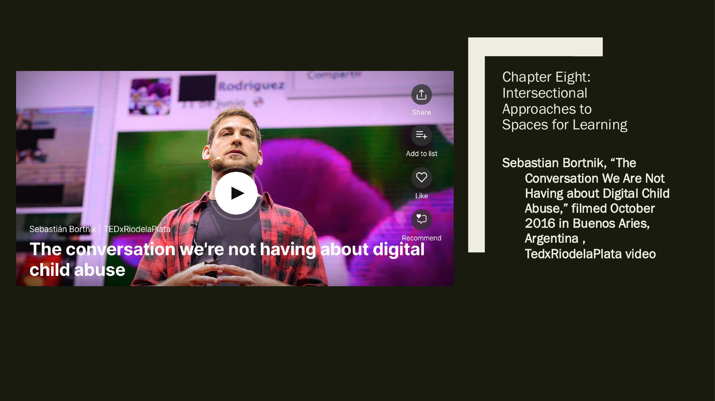
Digital Child Abuse
Sebastian Bortnik, “The Conversation We Are Not Having about Digital Child Abuse,” filmed October 2016 in Buenos Aires, Argentina, TEDxRiodelaPlata video
Resource referenced in the chapter materials
Notes:
Source: User-provided PDF, page 17.
Chapter Eight:
Intersectional
Approaches to
Spaces for Learning
Sebastian Bortnik, “The
Conversation We Are Not
Having about Digital Child
Abuse,” filmed October
2016 in Buenos Aries,
Argentina ,
TedxRiodelaPlata video

Slide 18
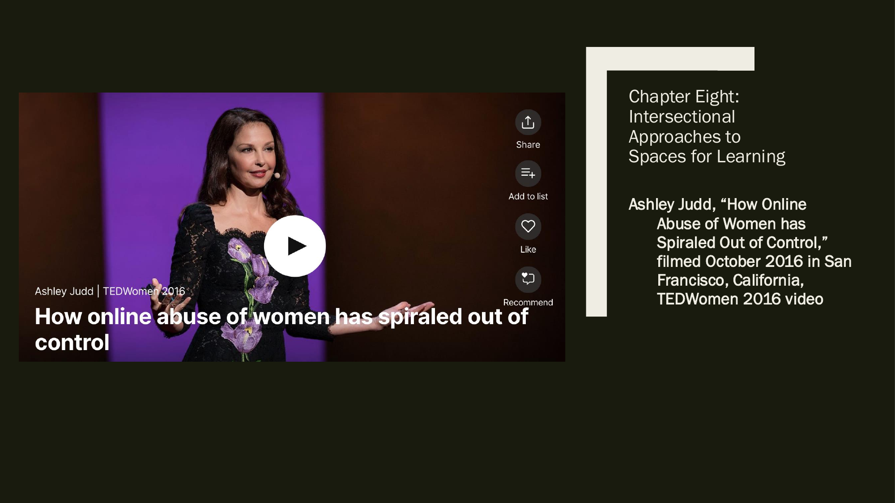
Online Abuse of Women
Ashley Judd, “How Online Abuse of Women has Spiraled Out of Control,” filmed October 2016 in San Francisco, California, TEDWomen 2016 video
Resource referenced in the chapter materials
Notes:
Source: User-provided PDF, page 18.
Chapter Eight:
Intersectional
Approaches to
Spaces for Learning
Ashley Judd, “How Online
Abuse of Women has
Spiraled Out of Control,”
filmed October 2016 in San
Francisco, California,
TEDWomen 2016 video

Slide 19

Hello Privilege, It’s Me, Chelsea
Alex Stapleton and Chelsea Handler, “Hello Privilege, It’s Me Chelsea,” 2019, Netflix
Resource referenced in the chapter materials
Notes:
Source: User-provided PDF, page 19.
Chapter Eight:
Intersectional
Approaches to
Spaces for Learning
Alex Stapleton and Chelsea
Handler, “Hello Privilege,
It’s me Chelsea,” 2019,
Netflix

Slide 20

Microaggressions in Conversation
chescaleigh [Franchesca Ramsey], “Shit White Girls Say … to Black Girls,” YouTube video
Resource referenced in the chapter materials
Notes:
Source: User-provided PDF, page 20.
Chapter Eight:
Intersectional
Approaches to
Spaces for Learning
chescaleigh [Franchesca
Ramsey], “Shit White Girls
Say … to Black Girls,”
YouTube video

Slide 21
Chapter Nine: Intersectional Approaches to Workplace Injustices
Chapter Outline
• In this chapter, you will find . . .
A Different Story of Poor Communities
Fast Fashion: Poverty Wages and Dreadful Working Conditions
• Inexpensive Clothing: At What Cost?
• Dangerous Conditions: Profits Not Safety
Wage Gaps: The Differences in Identities
The Myths of Poverty
• The Boot Strap Myth
• The Stigmatization of Poverty
Poverty and Epistemic Justice
Workplace Harassment: Real Time and Online
• Defining Workplace Harassment
• Identities and Workplace Harassment
• Sexual Harassment
Bullying
Listening to Subordinates Rather than Supervisors
Notes:
Source: User-provided PDF, page 21.
Chapter Nine: Intersectional Approaches
to Workplace Injustices
Chapter Outline
➢ In this chapter, you will find . . .
A Different Story of Poor Communities
Fast Fashion: Poverty Wages and Dreadful Working Conditions
➢ Inexpensive Clothing: At What Cost?
➢ Dangerous Conditions: Profits Not Safety
Wage Gaps: The Differences in Identities
The Myths of Poverty
➢ The Boot Strap Myth
➢ The Stigmatization of Poverty
Poverty and Epistemic Justice
Workplace Harassment: Real Time and Online
➢ Defining Workplace Harassment
➢ Identities and Workplace Harassment
➢ Sexual Harassment
Bullying
Listening to Subordinates Rather than Supervisors

Slide 22
Chapter Nine: Learning Objectives
Learning Objectives
After reading this chapter, you should be able to . . .
• Describe “fast fashion” and the impact of consumer culture on global and
transnational questions of identity and agency.
• Explain racism, sexism, and other forms of discrimination in terms of the wage
gap and structural violence.
• Assess the bootstrap myth of poverty and the rhetoric used to rationalize
inequality as an individual rather than structural issue.
• Analyze the intersectional relationships between self-determination and
poverty.
• Define workplace harassment, bullying, and a hostile work environment.
• Describe how taken-for-granted discourses, strategic ambiguity, and
exclusionary discourses are used to normalize workplace harassment.
Notes:
Source: User-provided PDF, page 22.
Chapter Nine: Intersectional Approaches
to Workplace Injustices
Learning Objectives
After reading this chapter, you should be able to . . .
➢ Describe “fast fashion” and the impact of consumer culture on global and
transnational questions of identity and agency.
➢ Explain racism, sexism, and other forms of discrimination in terms of the wage
gap and structural violence.
➢ Assess the bootstrap myth of poverty and the rhetoric used to rationalize
inequality as an individual rather than structural issue.
➢ Analyze the intersectional relationships between self-determination and
poverty.
➢ Define workplace harassment, bullying, and a hostile work environment.
➢ Describe how taken-for-granted discourses, strategic ambiguity, and
exclusionary discourses are used to normalize workplace harassment.

Slide 23
9.1 Guide to Communication
9.1 Guide to Communication: Talking Back to Systems of Workplace
Harassment (Part 1)
In order to explore ways we can change the discourse around bullying and
harassment, consider the following steps:
1. Understand Human Rights Violations.
According to the United Nations, “Human rights are rights inherent to all human
beings, regardless of race, sex, nationality, ethnicity, language, religion, or any
other status. Human rights include the right to life and liberty, freedom from
slavery and torture, freedom of opinion and expression, the right to work and
education, and many more. Everyone is entitled to these rights, without
discrimination.” How true is this for the places you work as well as the places in
which the items you buy are manufactured?
Notes:
Source: User-provided PDF, page 23.
Chapter Nine: Intersectional Approaches
to Workplace Injustices
9.1 Guide to Communication: Talking Back to Systems of Workplace
Harassment (Part 1)
In order to explore ways we can change the discourse around bullying and
harassment, consider the following steps:
1. Understand Human Rights Violations.
According to the United Nations, “Human rights are rights inherent to all human
beings, regardless of race, sex, nationality, ethnicity, language, religion, or any
other status. Human rights include the right to life and liberty, freedom from
slavery and torture, freedom of opinion and expression, the right to work and
education, and many more. Everyone is entitled to these rights, without
discrimination.” How true is this for the places you work as well as the places in
which the items you buy are manufactured?

Slide 24
9.1 Guide to Communication
9.1 Guide to Communication: Talking Back to Systems of Workplace
Harassment (Part 2)
2. Develop an Intersectional Vocabulary
In “Transforming Resistance,” communication scholars Shiv Ganesh, Heather Zoller &
George Cheney ask “to what degree do resistance efforts address multiple forms of
inequality and difference, such as gender, ethnicity, nationality, class, religion, and
sexuality?” Rather than hold individuals wholly responsible for workplace inequities,
explore the organizational discourses in the places you work and assess 1) who is
being held accountable and 2) which identities are clearly named as central to the
inequities that may be occurring.
3. Expand Your Own Narrative
Following Robin Clair’s research, examine the taken-for-granted, strategically
ambiguous, and exclusionary discourses in your own communication about
workplace inequities. Whose experiences are being valued and sanctioned? Whose
experiences are being concealed and devalued?
SOURCE: “Human Rights,” United Nations, 2018, http://www.un.org/en/sections/issues-depth/human-rights/ and Shiv Ganesh, Heather Zoller, and George Cheney, “Transforming
Resistance, Broadening Our Boundaries: Critical Organizational Communication Meets Globalization from Below,” Communication Monographs 72, no. 2 (2005), 181.
Notes:
Source: User-provided PDF, page 24.
Chapter Nine: Intersectional Approaches
to Workplace Injustices
9.1 Guide to Communication: Talking Back to Systems of Workplace
Harassment (Part 2)
2. Develop an Intersectional Vocabulary
In “Transforming Resistance,” communication scholars Shiv Ganesh, Heather Zoller &
George Cheney ask “to what degree do resistance efforts address multiple forms of
inequality and difference, such as gender, ethnicity, nationality, class, religion, and
sexuality?” Rather than hold individuals wholly responsible for workplace inequities,
explore the organizational discourses in the places you work and assess 1) who is
being held accountable and 2) which identities are clearly named as central to the
inequities that may be occurring.
3. Expand Your Own Narrative
Following Robin Clair’s research, examine the taken-for-granted, strategically
ambiguous, and exclusionary discourses in your own communication about
workplace inequities. Whose experiences are being valued and sanctioned? Whose
experiences are being concealed and devalued?
SOURCE: “Human Rights,” United Nations, 2018, http://www.un.org/en/sections/issues-depth/human-rights/ and Shiv Ganesh, Heather Zoller, and George Cheney, “Transforming
Resistance, Broadening Our Boundaries: Critical Organizational Communication Meets Globalization from Below,” Communication Monographs 72, no. 2 (2005), 181.

Slide 25
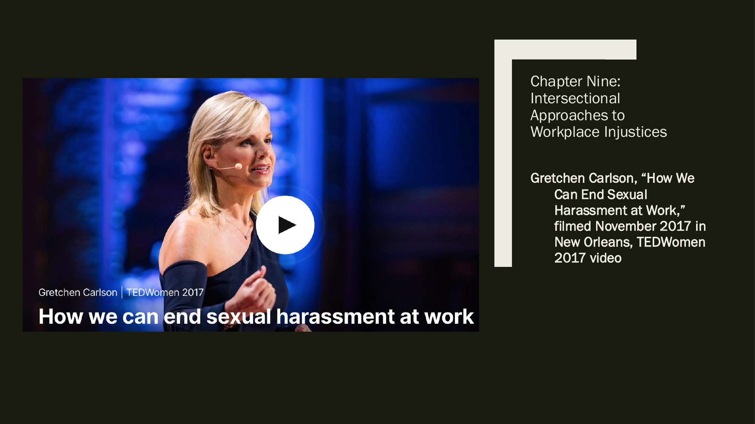
Ending Sexual Harassment at Work
Gretchen Carlson, “How We Can End Sexual Harassment at Work,” filmed November 2017 in New Orleans, TEDWomen 2017 video
Resource referenced in the chapter materials
Notes:
Source: User-provided PDF, page 25.
Chapter Nine:
Intersectional
Approaches to
Workplace Injustices
Gretchen Carlson, “How We
Can End Sexual
Harassment at Work,”
filmed November 2017 in
New Orleans, TEDWomen
2017 video

Slide 26

Sir Ken Robinson: Do Schools Kill Creativity?
Sir Ken Robinson, “Do Schools Kill Creativity?” filmed February 2006 in Monterey, California, TED 2006 video
Resource referenced in the chapter materials
Notes:
Source: User-provided PDF, page 26.
Chapter Nine:
Intersectional
Approaches to
Workplace Injustices
Sir Ken Robinson, “Do
Schools Kill Creativity?”
filmed February 2006 in
Monterrey, California,
Ted2006 video

Slide 27
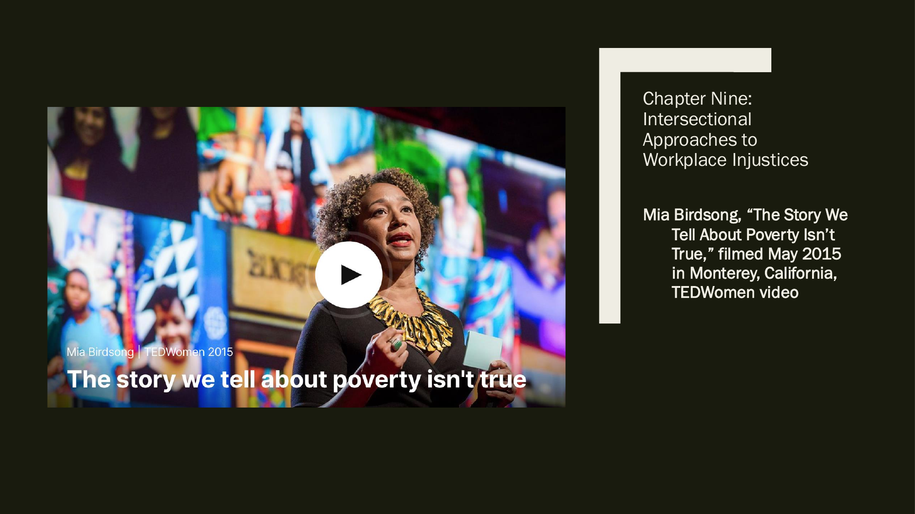
The Story We Tell About Poverty
Mia Birdsong, “The Story We Tell About Poverty Isn’t True,” filmed May 2015 in Monterey, California, TEDWomen video
Resource referenced in the chapter materials
Notes:
Source: User-provided PDF, page 27.
Chapter Nine:
Intersectional
Approaches to
Workplace Injustices
Mia Birdsong, “The Story We
Tell About Poverty Isn’t
True,” filmed May 2015
in Monterey, California,
TEDWomen video

Slide 28

Black Workers and Workplace Conditions
Mallory Simon and Sara Sidner, “Black Workers Describe Details of ‘Living Hell’ at UPS Center in Ohio,” CNN
Resource referenced in the chapter materials
Notes:
Source: User-provided PDF, page 28.
Chapter Nine:
Intersectional
Approaches to
Workplace Injustices
Mallory Simon and Sara
Sidner, “Black Workers
Describe Details of
‘Living Hell’ at UPS
Center in Ohio,” CNN

